Slide 1
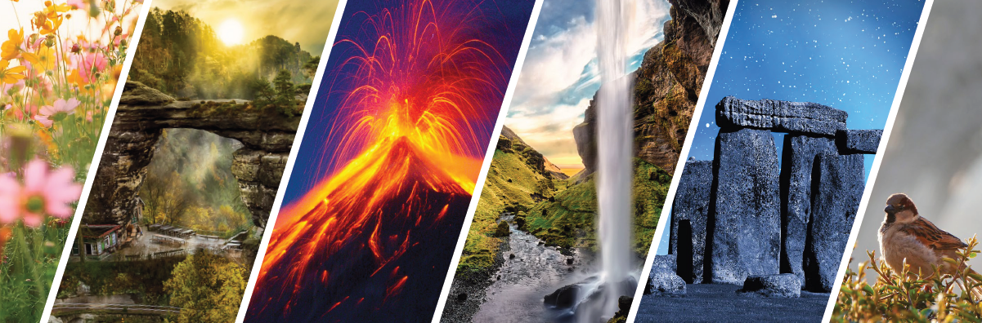
Nature Heritage of Europe – classification, protection, SDG
Methodology of Interpretation of European Nature Heritage in Tourism

Slide 2
Nature heritage definition
“Nature heritage refers to natural features, geological and physiographical formations and delineated areas that constitute the habitat of threatened species of animals and plants and natural sites of value from the point of view of science, conservation or natural beauty. It includes private and publicly protected natural areas, zoos, aquaria and botanical gardens, natural habitat, marine ecosystems, sanctuaries, reservoirs etc..” (UNESCO Institute for Statistics, 2009).

Slide 3
NaturE heritage
In a dramatically changing world, with a growing demand for resources nature is under threat.
The 1972 convention No. 15511 for the protection of the world cultural and nature heritage defines what is to be considered as cultural and nature heritage.
The convention considers physical and biological natural features, geological formations and natural sites and areas that are of universal value from an aesthetic or scientific point of view as well as habitats of endangered plants or animals or sites with an outstanding value for science, conservation or natural beauty as natural heritage worth protecting. (UNESCO, 1972, p. 153-154).

Slide 4
Nature heritage
Tremendously increasing demand for resources needed by growing world population.
Increasing travel activities of the world's population since the 1970s.
Economic growth in recent decades especially in the Asian Pacific causing even greater pressure on nature heritage.

Slide 5
Impact of tourism on naturE heritage
Nature sites are attracting millions of visitors each year.
Overtourism might seriously endanger nature heritage.
Nature heritage sites and their attractiveness represent economic advantage.
To protect both natural heritage and economic advantage there are numerous European initiatives endeavouring to safeguard sustainable economic development and raise awareness of how fragile nature heritage is.

Slide 6
Classification of NATURE heritage
UNESCO (1972) distinguishes not just between cultural and nature heritage, but also between „mixed cultural and nature heritage“ and „cultural landscapes“ (UNESCO, 2015; Sun, 2010; Wallach, 2005).
Mixed cultural and nature heritage is defined by UNESCO if it fulfils a part of definitions of cultural and nature heritage.
Cultural landscapes are defined as cultural properties (UNESCO, 2015), which represent „the combined works of nature and a man“.

Slide 7
Classification of nature heritage
Geological heritage (i.e. strata with ancient biological fossils)
Biological heritage (i.e. habitat of animals and plants; including geological and physiographic formations)
Topographical heritage (Hua, 2010)

Slide 8
Categories of nature heritagE UNESCO (2015)
Large-scale protected areas and national parks
Hydrology and balneological resources
Cultural landscapes, palace gardens, ZOOs and botanic gardens
Geoparks, coastal landscape and inanimate nature
Small-scale protected areas, regional parks and nature reserves
Island landscape, agricultural landscapes and vineyards
UNESCO locations
Caves and extreme nature heritage

Slide 9
Challenges for biodiversity and naturE heritage protection
Access to robust and reliable data
Management of Natura 2000 network
Assessment of ecosystem services
Knowledge gap
Financing

Slide 10
Protection of nature heritage in europe
2030 Agenda for Sustainable Development (United Nations, 2021)
17 Sustainable Development Goals (SDGs) – representing an urgent call for action by all countries – (advanced and developing) in a global partnership
Each one of SDGs has an intersection with natural heritage protection, and is to be achieved by 2030.

Slide 11
Sustainable development goals (SDGs)

Slide 12
EU INITIATIVES EuroNatur Foundation
Founded in Germany in 1987.
Aims to promote the conservation of biodiversity in Europe as well as to protect endangered species and their habitats.
Sustainable development is to be supported (especially in the field of agriculture and tourism).
Transboundary cooperation in ecological projects and environmental lobbying as well as the promotion of ecological awareness.
Directly addresses the SDGs 11, 12, 14 and 15.

Slide 13
EU INITIATIVES NATURA 2000 NETWORK
Covers about 27,000 sites, about one fifth of the EU‘s land area and a large part of marine waters (European Commission, 2018).
Allows EU countries to cooperate within a common legal framework to protect threatened species and valuable natural habitats.
Covers different ecosystems, but also cultural heritage sites.
Offers many opportunities for tourism and recreation in a healthy environment and related cultures and lifestyles.
Almost 20 % of 365 World Heritage sites in the EU are located in or directly bordering to a Natura 2000 site (European Commision, 2018).
Adressess the SDGs 11, 12, 14 and 15.

Slide 14
EU RESEARCH AND DEVELOPMENT PROJECTS
Attempts are being made to take the aspect of sustainability and nature into account.
The focus is to win tourists in the long term for the travel motive of direct experience of natural heritage, but also to sensitize tourists for sustainability and correct handling of natural heritage.
Projects and initiatives are irreplaceable components of natural heritage conservation – it is needed to promote sustainable behavior of individuals.
There is often a gap between awareness and actual behavior.
Psychology approaches – conditions for the likelihood of the transformation form an attitude to behavior, approaches to promote sustainable behaviors.

Slide 15
PsychologY approaches „tact“ PRINCIPLE
Target
Action
Context
Time
„correspondence principle“
The more similiar attitude and behavior are in terms of the fit of the following TACT items, the better behavior can be predicted from an existing attitude.
We ask questions such as:
To what extent public transport is generally seen as a way to protect the environment?
How important this attitude is to a respective person?
Does the person plan to perform this behavior during a trip?
Ajzen & Fishbein (1977)

Slide 16
Psychology approaches Interindividual differences
Low tendency
High Tendency
There is a difference in the extent to which an attitude is directly translated to behavior.
Low tendency towards self-monitoring – more immediate transformation of attitudes/behavior, predictions are easier.
High tendency to self-monitoring – base their behavior in social situations on the behavior of others (Snyder, 1979).

Slide 17
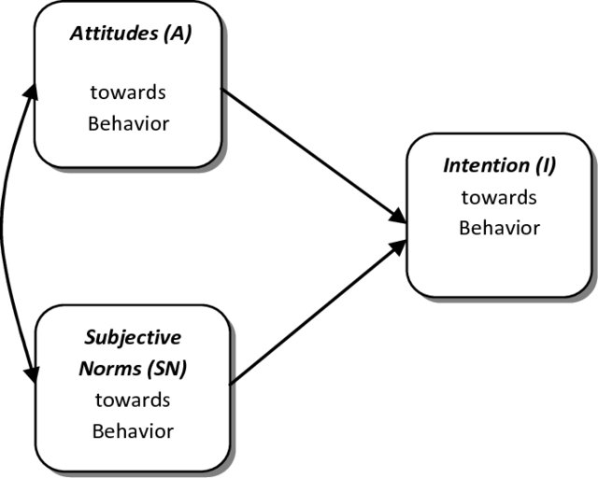
Psychology approaches THEORY OF REASONED ACTION
Human behavior is influenced by person-specific attitudes and by social factors.
Not only does an environmentally friendly attitude favour environmentally friendly behaviors, but also the opinion of the others is important (e.g. Role models, parents, friends, etc.) regarding these behaviors, whether they are actually shown.
Theory of Reasoned Action (Ajzen & Fishbein, 1980; quoted after Özer & Yilmaz, 2010, p. 52)

Slide 18
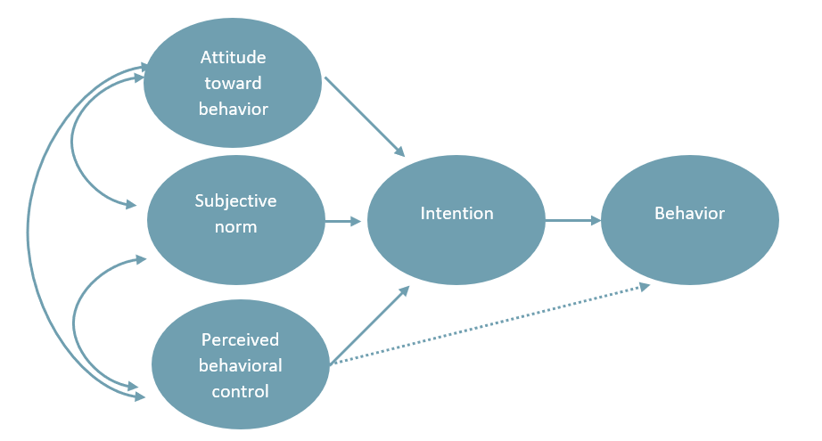
Psychology approaches Theory of planned behavior
The perception that a person has the necessary skills and resources to perform a certain behavior.
The person needs to be convinced that they are capable of implementing sustainable behaviors.
Theory of Planned Behavior (Ajzen & Madden, 1986; quoted after Helgeson, Dietz & Chabay, 2014, p. 12)

Slide 19
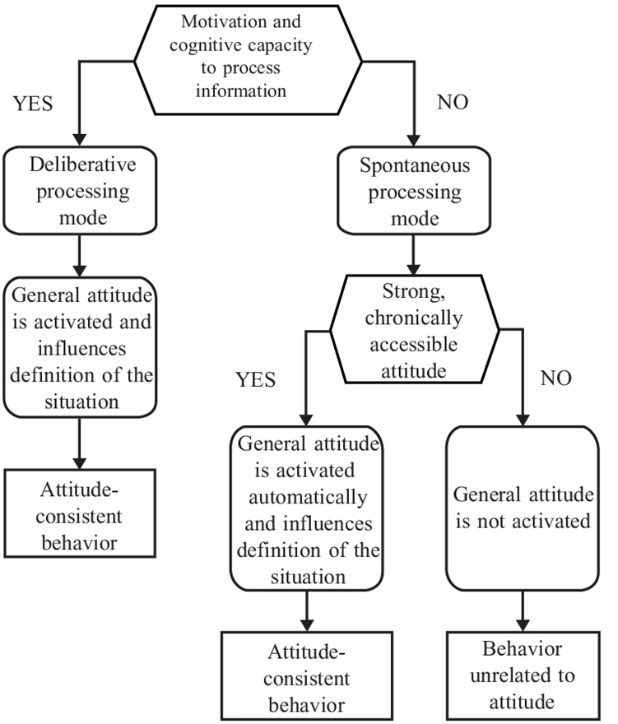
Psychology approaches Alternative models
Repetitive behavior
The person shows environmentally friendly behavior below the level of awareness in an automated way.
MODE model (Motivation and Opportunity as Determinants of Behavior; Fazio, 1990)
An attitude only comes into play if it has sufficient availability.

Slide 20
Social incentives comparing and competing with others
Immediate rewards
Process monitoring
Valuing rewards received immediately more highly.
What happens if we reward people now for actions that have a positive long-term impact on sustainability?
The registration is no longer necessary after a certain point, as habits or routines have developed.
Processing positive information „more efficiently“ than negative information (Bodenmüller, 2021).
Positive consequences should be named when seeking sustainable behavior change.

Slide 21
Summary
Overtourism might seriously endanger nature heritage.
Protection of nature heritage
2030 Agenda for Sustainable Development
17 Sustainable Development Goals (SDGs)
EU initiatives - EuroNatur Foundation, Natura 2000 Network
Psychology approaches
„TACT“ principle
Interindividual differences
Theory of reasoned action
Alternative models

Slide 22
references
Ajzen, I., & Fishbein, M. (1980). Understanding attitudes and predicting social behavior (Pbk. ed.). Englewood Cliffs, N.J: Prentice-Hall.
Bodenmüller, K. (2021). Freudenschreie werden stärker wahrgenommen als Angst- oder Wutgebrüll. Retrieved from https://idw-online.de/de/news?print=1&id=766628
European Commission (2018). Europe’s cultural and natural heritage in Natura 2000. Retrieved from https://ec.europa.eu/environment/nature/natura2000/management/pdf/Nature-and-Culture-leaflet-web.pdf
Fazio, R. H. (1990). Multiple processes by which attitudes guide behavior: The MODE model as an integrative framework. In M.P. Zanna (Ed.), Experimental Social Psychology (pp. 75–109). San Diego, CA: Academic Press.
Hua, S. (2010). World Heritage Classification and Related Issues—A Case Study of the “Convention Concerning the Protection of the World Cultural and Natural Heritage”. Procedia - Social and Behavioral Sciences, 2(5), 6954–6961. https://doi.org/10.1016/j.sbspro.2010.05.048

Slide 23
references
Snyder, M. (1979). Self-Monitoring Processes. In Advances in Experimental Social Psychology. Advances in Experimental Social Psychology Volume 12 (Vol. 12, pp. 85–128). Elsevier. https://doi.org/10.1016/S0065-2601(08)60260-9
UNESCO Institute for Statistics (2009). 2009 UNESCO Framework for Cultural Statistics and UNESCO, Convention Concerning the Protection of the World Cultural and Natural Heritage, 1972. Retrieved from http://uis.unesco.org/en/glossary-term/natural-heritage
UNESCO (2015). Operational Guidelines for the Implementation of the World Heritage Convention. Paris: UNESCO World Heritage Centre.
United Nations (2021). THE 17 GOALS. Retrieved from https://sdgs.un.org/goals
Wallach, B. (2005). Understanding cultural landscape. New York: The Guilford Press.

Slide 24
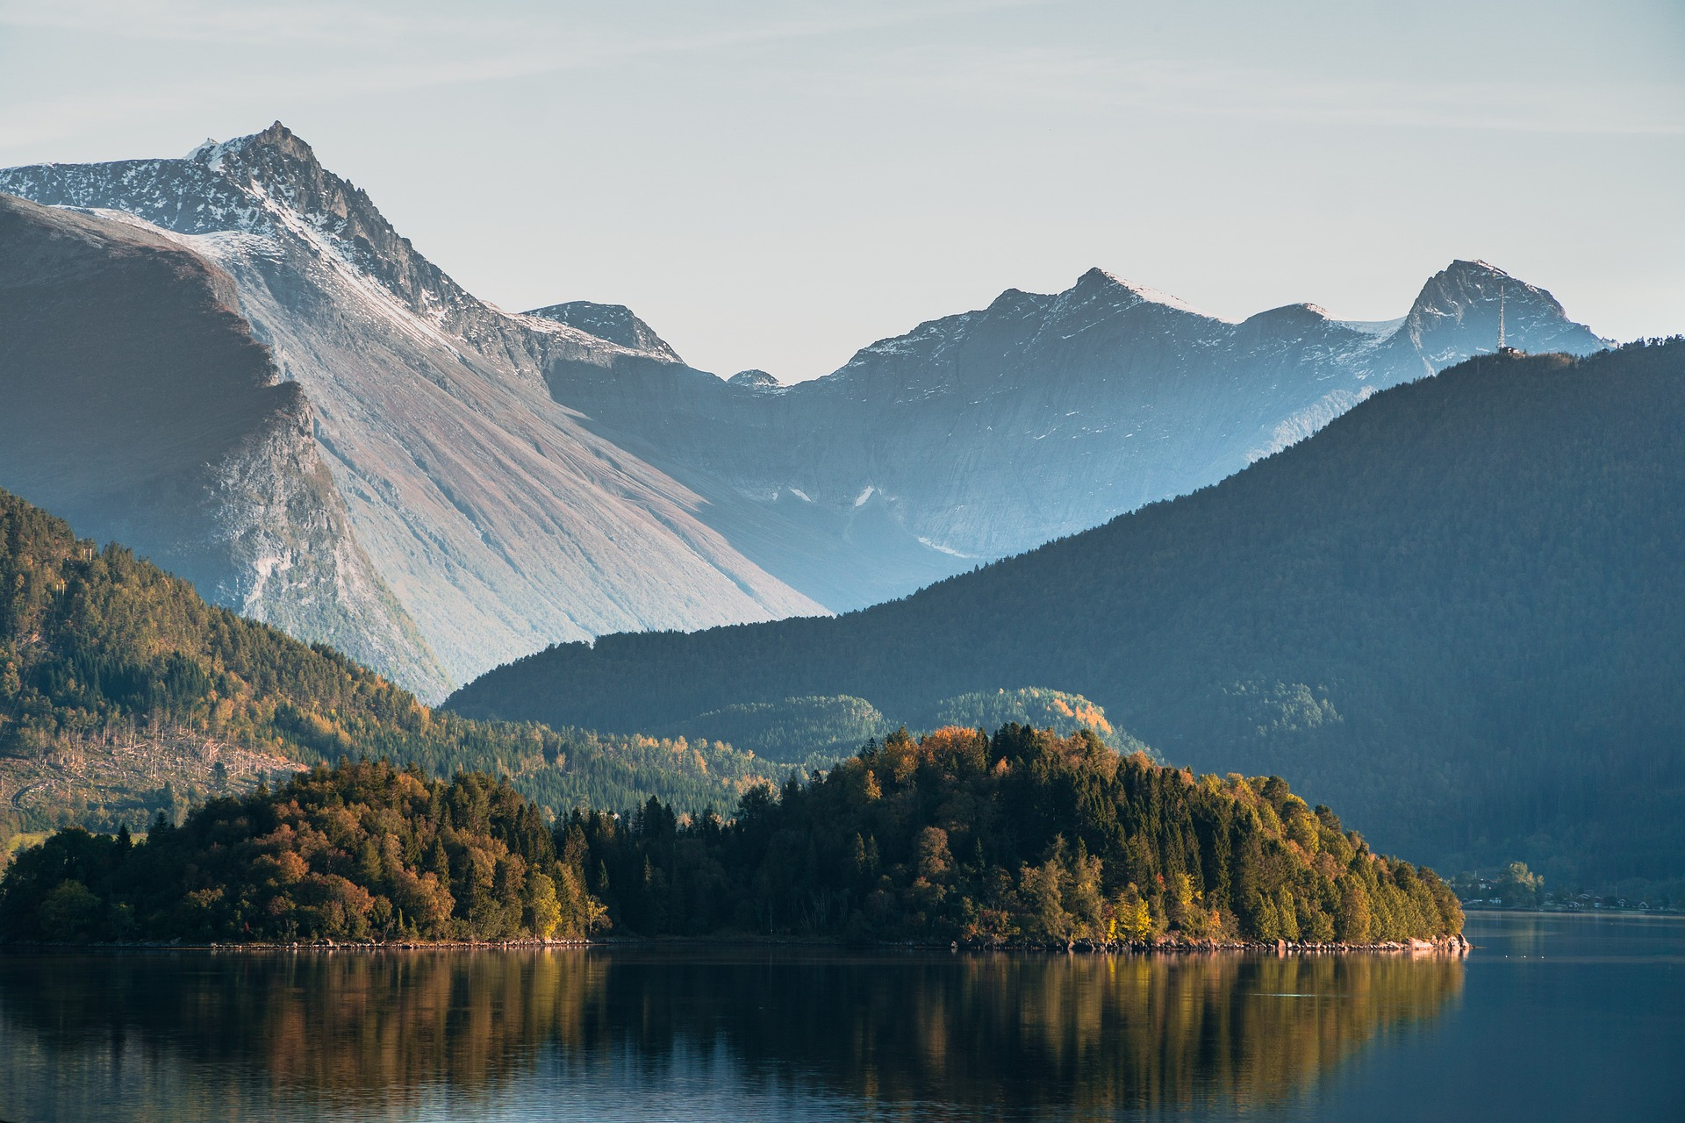
Output of the Erasmus+ K2 Strategic Partnership Project Nr. 2020-1-CZ01-KA203-078407 „Methodology of Interpretation of European Nature Heritage in Tourism" 2020 – 2023
Participating universities and their academic teams
Prague University of Economics and Business, Czech Republic;
Alexandru Ioan Cuza University of Iași, Romania;
Fachhochschule des Mittelstands, Germany;
Munster Technological University, Cork, Ireland
Universidad Europea de Madrid, Spain;
Universidade do Porto, Portugal;
University of Applied Sciences Burgenland, Austria;
Vytauto Didziojo Universitetas, Lithuania.

