Slide 1
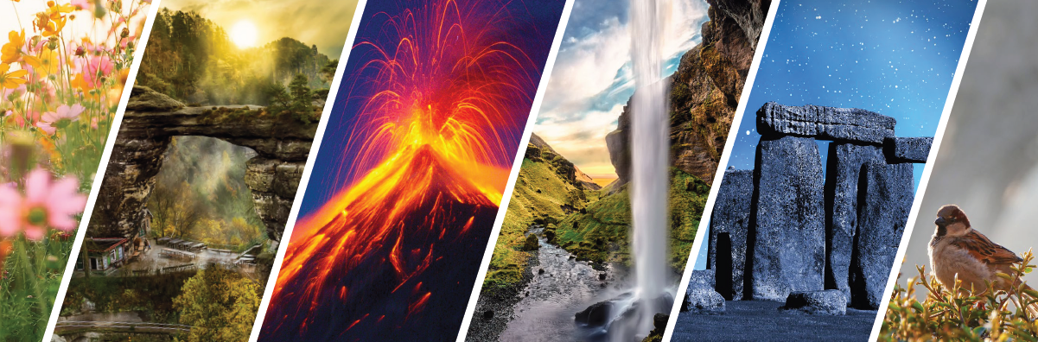
Nature-based tourism, economic impact
Methodology of Interpretation of European Nature Heritage in Tourism

Slide 2
Nature-based tourism
Stimulates a particular type of action by people motivated by the wish to enjoy wildlife or remote natural areas or simply discover areas untouched by civilization (World Bank, 2017).
Motivation of tourists travelling to natural parks is related to self-development, escape from routine, experience of nature, and general entertainment (Carrascosa-López, Carvache-Franco, Mondéjar-Jiménez, 2021).
Tolerability thresholds (carrying capacity) – high level of tourism frequency can cause deterioration of natural environment

Slide 3
effects of tourism
Benefits to all stakeholders
Economic growth – world, national, regional, local GDP
Wealth creation, social development
Improvement of people‘s wellbeing
Stimulation of international trade – infrastructure development, low income economies support (World Bank, 2017)
Large-scale human intervention – rural or remote areas at risk
Tourism-generated employment essential for the local population

Slide 4
Nature-based tourism
An inherent part of the tourism industry
Urban lifestyles, modern facilities and overal comfort levels – enstragement of many people from nature
Globalization and technology – reduction in seasonality
Return to nature may be regarded as a rebound to „a land of hope and simplicity“
A widespread use of various complementary forms to describe nature-based tourism: eco-tourism, sustainable tourism, adventure tourism, alternative tourism, green tourism, responsible tourism, soft tourism, eco-travelling, etc.

Slide 5
Nature-based activities definition
„Travelling to relatively undisturbed and uncontaminated areas with the specific aim to study, admire and enjoy the scenery, plants and wild animals as well as any cultural manifestation existing in those areas“ (Luzar, 1995).
„Natural environment-based forms of leisure activities including numerous activities, from sitting under a tree to hiking in the wild“ (Naidoo et al, 2011).
Also called nature tourism
The pleasure of enjoying natural areas and observing nature (Lucas, 1984)
„Tourism based on the natural attractions of an area including responsible travel to experience natural areas and their landscape, flora and fauna, protecting the environment and improving the quality of life of locals“ (CBI, 2020).

Slide 6
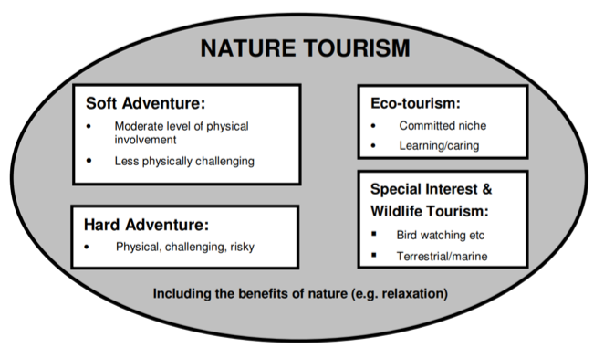
Categories in nature tourism

Slide 7
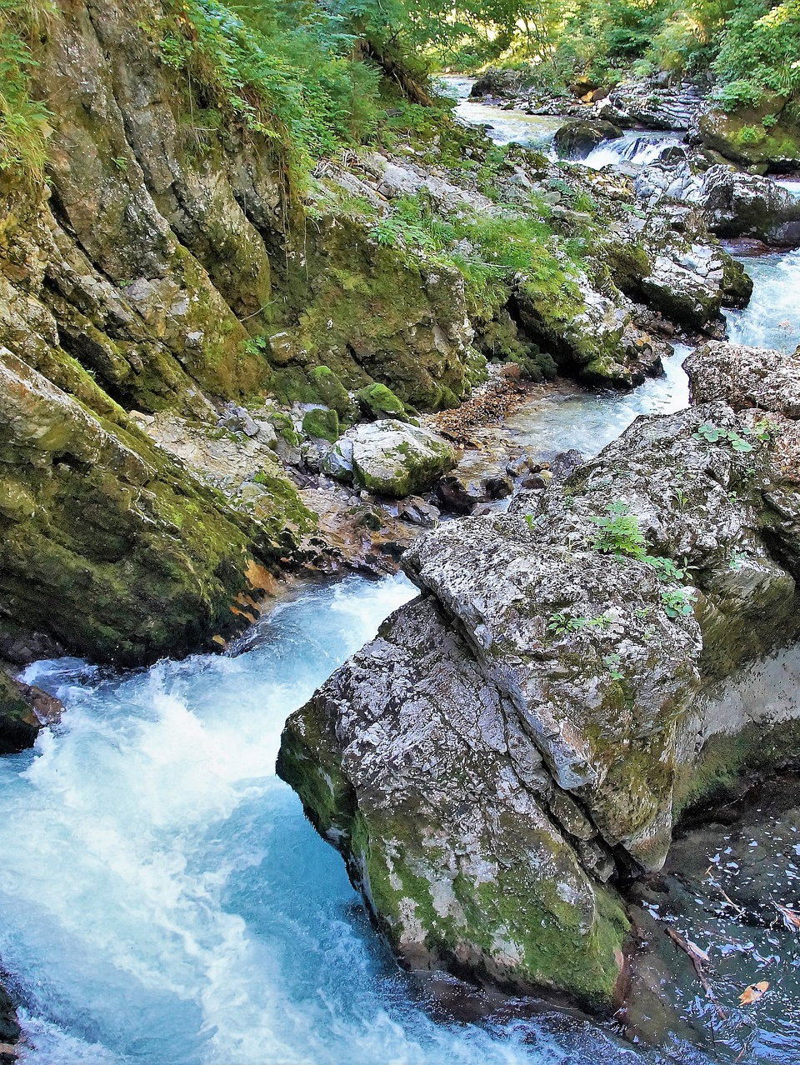
Eco-tourism
„Responsible travel to natural areas that respects the environment, sustains the well-being of the local people, and creates knowledge and understanding through interpretation and education of all involved: visitors, staff and the visited“ (The Global Ecotourism Network, 2016).
One of the main drivers of the increasing tourist demand for nature-based tourism.

Slide 8
Nature tourism demand
The demand for nature and ecotourism is high and will continue to grow
Disturbance of remoteness of some remote areas
Many opportunities if practices are adopted that conserve and respect nature
Top European nature and ecotourism markets are Germany, France and the Netherlands

Slide 9
tourism as an industry
A sensitive industry, especially prone to disasters and crises
Domestic tourism is recovering more quickly after social or economic crisis compared to international travel
There is a need to increase accessibility to domestic attractions
Future studies must review pre-COVID and post-COVID challenges in promoting domestic tourism

Slide 10
POST-covid changes in tourism behavior
Natural attractions are likely to exert a stronger pull than before, with travellers and tourists seeking to avoid crowds and polluted cities.
Virtual travel and other digital services, remote working, social welfare programmes, healthcare services.
Even greater need to develop a truly holistic valuation of „nature-dependent tourism“ – link to, and dependency on nature and natural ecosystems (Spalding et al., 2021).
The need to be encouraged to pull a new demand by changing unsustaiable product offer.

Slide 11
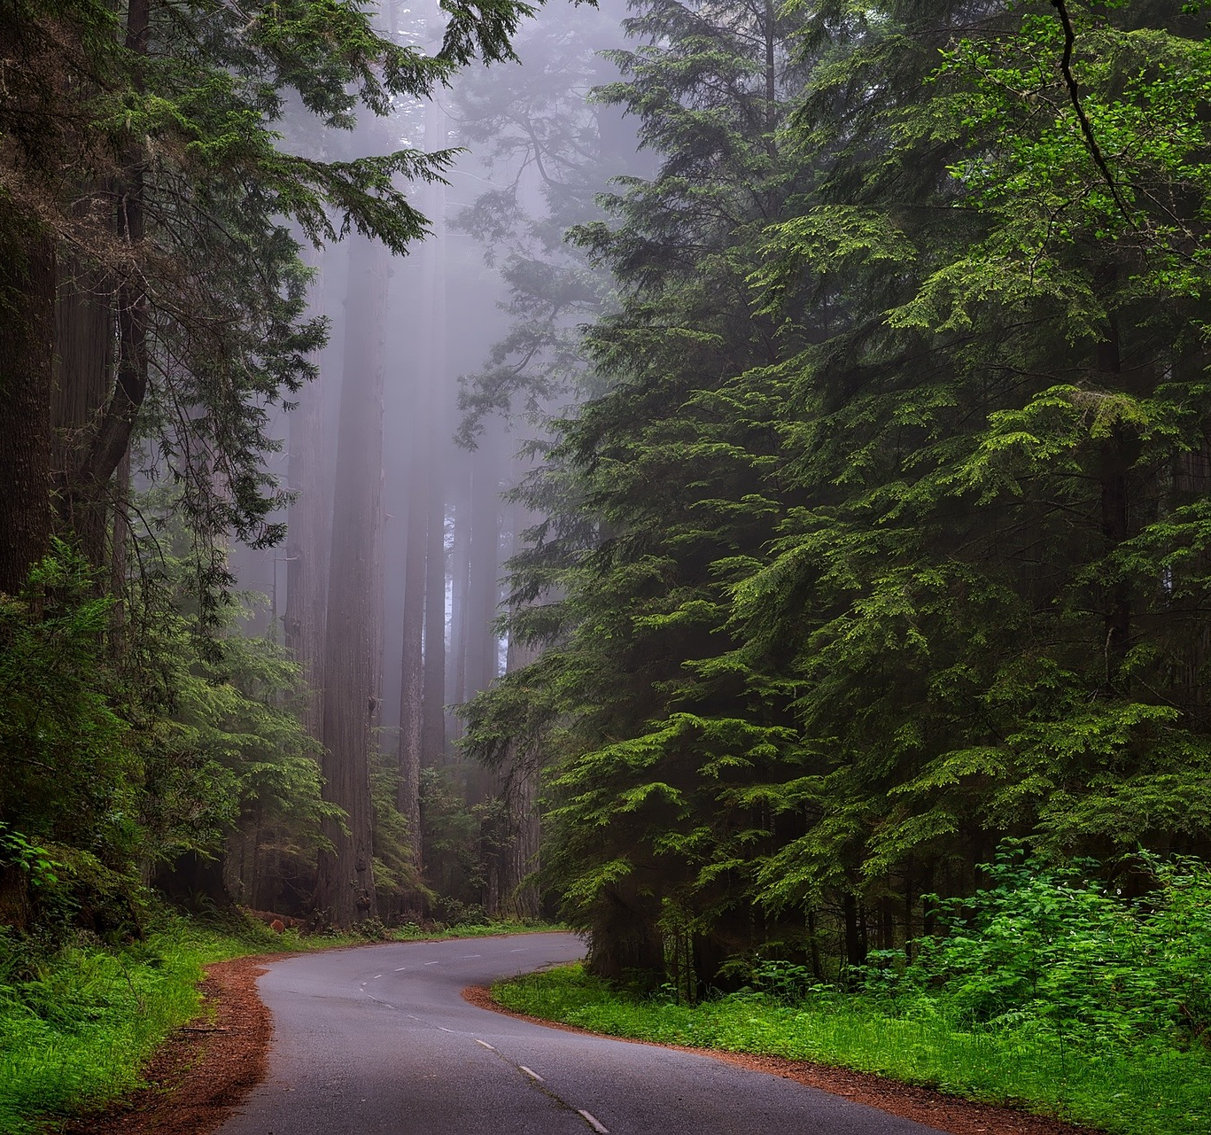
ECONOMIC BENEFITS of nature tourism
local community‘s welfare
community‘s overall wellbeing
GDP growth
Generation of employment

Slide 12
EVALUATION OF ECONOMIC effects
Tourism Satellite Account
Multiplier models
Implemented by most countries
Allows estimation of direct impact
Direct and indirect impact of tourism at the regional and national level is calculated
Access to data which enable comparison between various regions and countries.
Direct and indirect impact can be determined.
Data available at the European level.

Slide 13
Motivation
Four main motivations:
Social change is taking place in society‘s relationship with nature
Evolution of environmental attitudes
Increase in environmental education
Incorporation of environmental information
New perception and requirements on natural space occur
Taking the form of new demand linked to tourism, recreation and education
the search for experiences in and through nature
rest and relaxation in natural settings that are considered pleasurable
the development of skills and abilities in nature
health and fitness

Slide 14
Segmentation
Naturalists and admirers of nature
Adventurous mountaineers
Informed nature tourists
Campers
Occasional nature tourists
The greater the degree of specialization of a tourist, the more specialized natural areas from the point of view of resources and adaptation to their interests are demanded.
Nature-based tourism attracts tourists whose motivation are recreational and leisure activities, the interpretation and/or knowledge of nature, with varying degrees of depth and practice of sporting activities with a use of natural resources.

Slide 15
Motivations to establish a general segmentation
Tourism in nature: Leisure tourism in nature
Takes place in nature, participants don´t have any specialized motivation.
The largest and most generic group (motivation such as rest, relaxation).
Nature tourism: Active sports tourism in nature
Certain elements of nature are used for sporting activities or active tourism, such as mountaineering, climbing, canoeing, trekking and all other sporting and adventure activities.
Participants do not require facilities or transformation of natural resources.
Nature tourism: Ecotourism
Activities most closely related to the environment.
Main motivation for visiting natural areas is explicitly to appreciate and get to know nature and the landscape as a whole.

Slide 16
Summary
Effects of tourism
Eco-tourism as one of the main drivers of the increasing tourist demand for nature-based tourism.
The demand for nature and ecotourism is high and will continue to grow.
Tourism is a sensitive industry.
Post-covid changes in tourism behavior
Motivation and segmentation

Slide 17
references
Carrascosa-López, C., Carvache-Franco, M., Mondéjar-Jiménez, J., & Carvache-Franco, W. (2021). Understanding Motivations and Segmentation in Ecotourism Destinations. Application to Natural Parks in Spanish Mediterranean Area. Sustainability 13, 4802. https://doi.org/10.3390/su13094802
CBI. (2020). The European market potential for nature and ecotourism. Available at https://www.cbi.eu/market-information/tourism/nature-tourism/nature-eco-tourism/market-potential
Lucas, P. H. C. (1984). How protected areas can help meet society's evolving needs. In J.A. McNeely, and K.R. Miller, eds, National parks, conservation, and development, Smithsonian Institution Press, Washington D.C.
Luzar, E. J., Diagne, A., Gan, C., & Henning, B. R. (1995). Evaluating nature-based tourism using the new environmental paradigm. Journal of Agricultural and applied Economics, 27(2), 544-555.

Slide 18
references
Naidoo, P., Ramseook-Munhurrun, P., & Seegoolam, P. (2011). An assessment of visitor satisfaction with nature-based tourism attractions. International journal of management and marketing research, 4(1), 87-98.
Spalding, M., Lauretta Burke, L., & Fyall, A. (2021). Covid-19: implications for nature and tourism, Anatolia, 32(1), 126-127, DOI: 10.1080/13032917.2020.1791524
World Bank Group and International Finance Corporation. (2017). Tourism for Development. 20 Reasons Sustianble Tourism Counts for Development, World Bank Group, Available from:http://documents1.worldbank.org/curated/en/558121506324624240/pdf/119954-WP-PUBLIC-SustainableTourismDevelopment.pdf, [accessed Apr 27 2021].

Slide 19
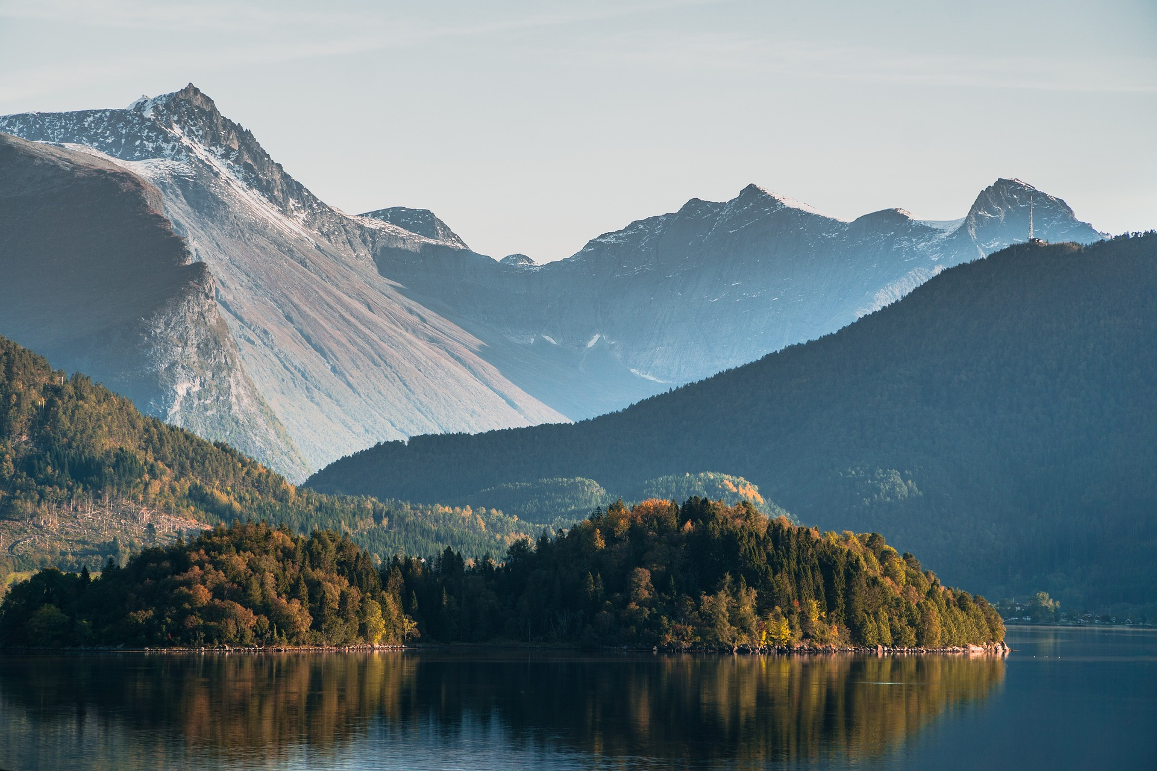
Output of the Erasmus+ K2 Strategic Partnership Project Nr. 2020-1-CZ01-KA203-078407 „Methodology of Interpretation of European Nature Heritage in Tourism" 2020 – 2023
Participating universities and their academic teams
Prague University of Economics and Business, Czech Republic;
Alexandru Ioan Cuza University of Iași, Romania;
Fachhochschule des Mittelstands, Germany;
Munster Technological University, Cork, Ireland
Universidad Europea de Madrid, Spain;
Universidade do Porto, Portugal;
University of Applied Sciences Burgenland, Austria;
Vytauto Didziojo Universitetas, Lithuania.

