Slide 1
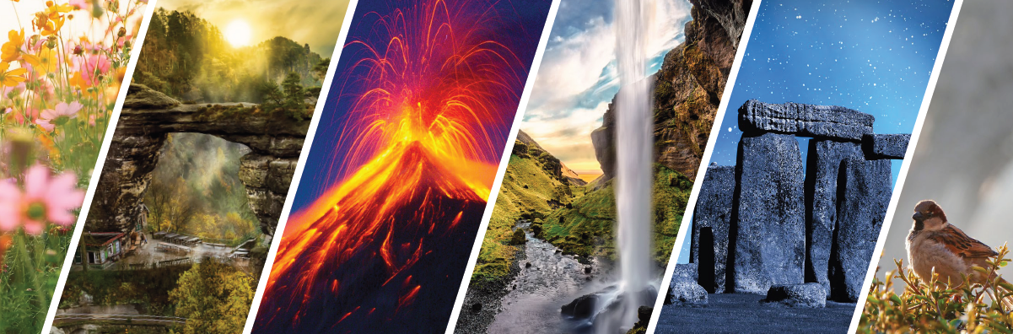
Interpretation of Nature Heritage – specifics, methods
Methodology of Interpretation of European Nature Heritage in Tourism

Slide 2
Specifics of nature attractions
Nature refers to the physical and material world.
Nature environments or wilderness usually refer to the habitat of wild animals, rocks, forests, and all the components that have not been considerably transformed by human intervention or that persist despite human intervention.
Nature attractions are unique geographical or biological landscapes as they have been shaped by the surrounding environment’s exclusive nature forces (Martini et al., 2017).
Nature attractions: deserts, polar regions, rainforests, alpine areas, woodlands, grasslands, mountains, beaches, swamps, caves, oceans, cliffs, lakes, rivers, and unique life forms which inhabit those environments like animals, birds, insects, and plants (Blicharska et al., 2016).

Slide 3
interpretation
Interpretation refers to how sites are presented to visitors.
Interpretation can reflect how the site is used, seen, heard, touched, smelt, and perceived (Carr, 2004).
It is a process of understanding and choosing the appropriate techniques for impacting evocative stories and meanings of the site.

Slide 4
Nature areas challenges
Climate change – the actual changes in temperature, rainfall, and other weather variables can decrease the number of visitors (Markham et al., 2016) and interrupt the socio-economic activities at a cultural landscape area (Change, 2019).
Impact on biodiversity – Matching site visits with the best times of year for growth and reproduction are necessary to maintain a high and safe number of visitors to the nature attraction.

Slide 5
INTERPRETATION
Interpretation is a communication process designed to reveal meanings and relationships of cultural and nature heritage to the public (Hvenegaard et al., 2009).
The interpretation efficacy relies on a complete understanding of the site and choosing the appropriate techniques to enhance the visitors’ experience and the site’s uniqueness.

Slide 6
General methods and techniques of nature heritage interpretation
Personal interpretation
Direct contact with visitors
Exchange, interaction and response to the visitors‘ needs and requests
Forms: talks, demonstrations, puppet shows, living history, storytelling, nature walks, tours, guided tours, workshops
Non-personal interpretation
Multiple tools and media – brochures, interpretative boards, signs, videos, digital media support as mobile phone applications, virtual reality tours, self-guided trails, exhibitions
The visitor can decide which tour to take and which kind of information to read and use
Complete accessibility – anytime, anywhere, in various languages, displayed on many supporting platforms

Slide 7
Place of the interpretation
Inside the property („in situ“)
Allows the visitors to discover the nature attraction via different forms of tours.
Beyond the property („ex-situ“)
Usually held outside the nature attraction, so the interpretation is sent through newsletters, television, radio, newspapers, blogs, social media, and websites, exhibitions in visitor centres, etc.

Slide 8
guided visits/TOURS
Group travel experiences led by a guide following a specific itinerary around sites and landscapes of a city or a region (de Rojas & Camarero, 2008).
The guide interprets the cultural and nature heritage and environment in the language of the visitors’ choice (Chang, 2014).
Convenient, include expert guides that provide exciting background information on every place the tourists visit (Crespi-Vallbona, 2021).

Slide 9
workshops
Usually a brief group discussion for a relatively small group of people.
Focused mainly on techniques and skills regarding an excursion or an activity related to tourism (Dwyer et al., 2009).

Slide 10
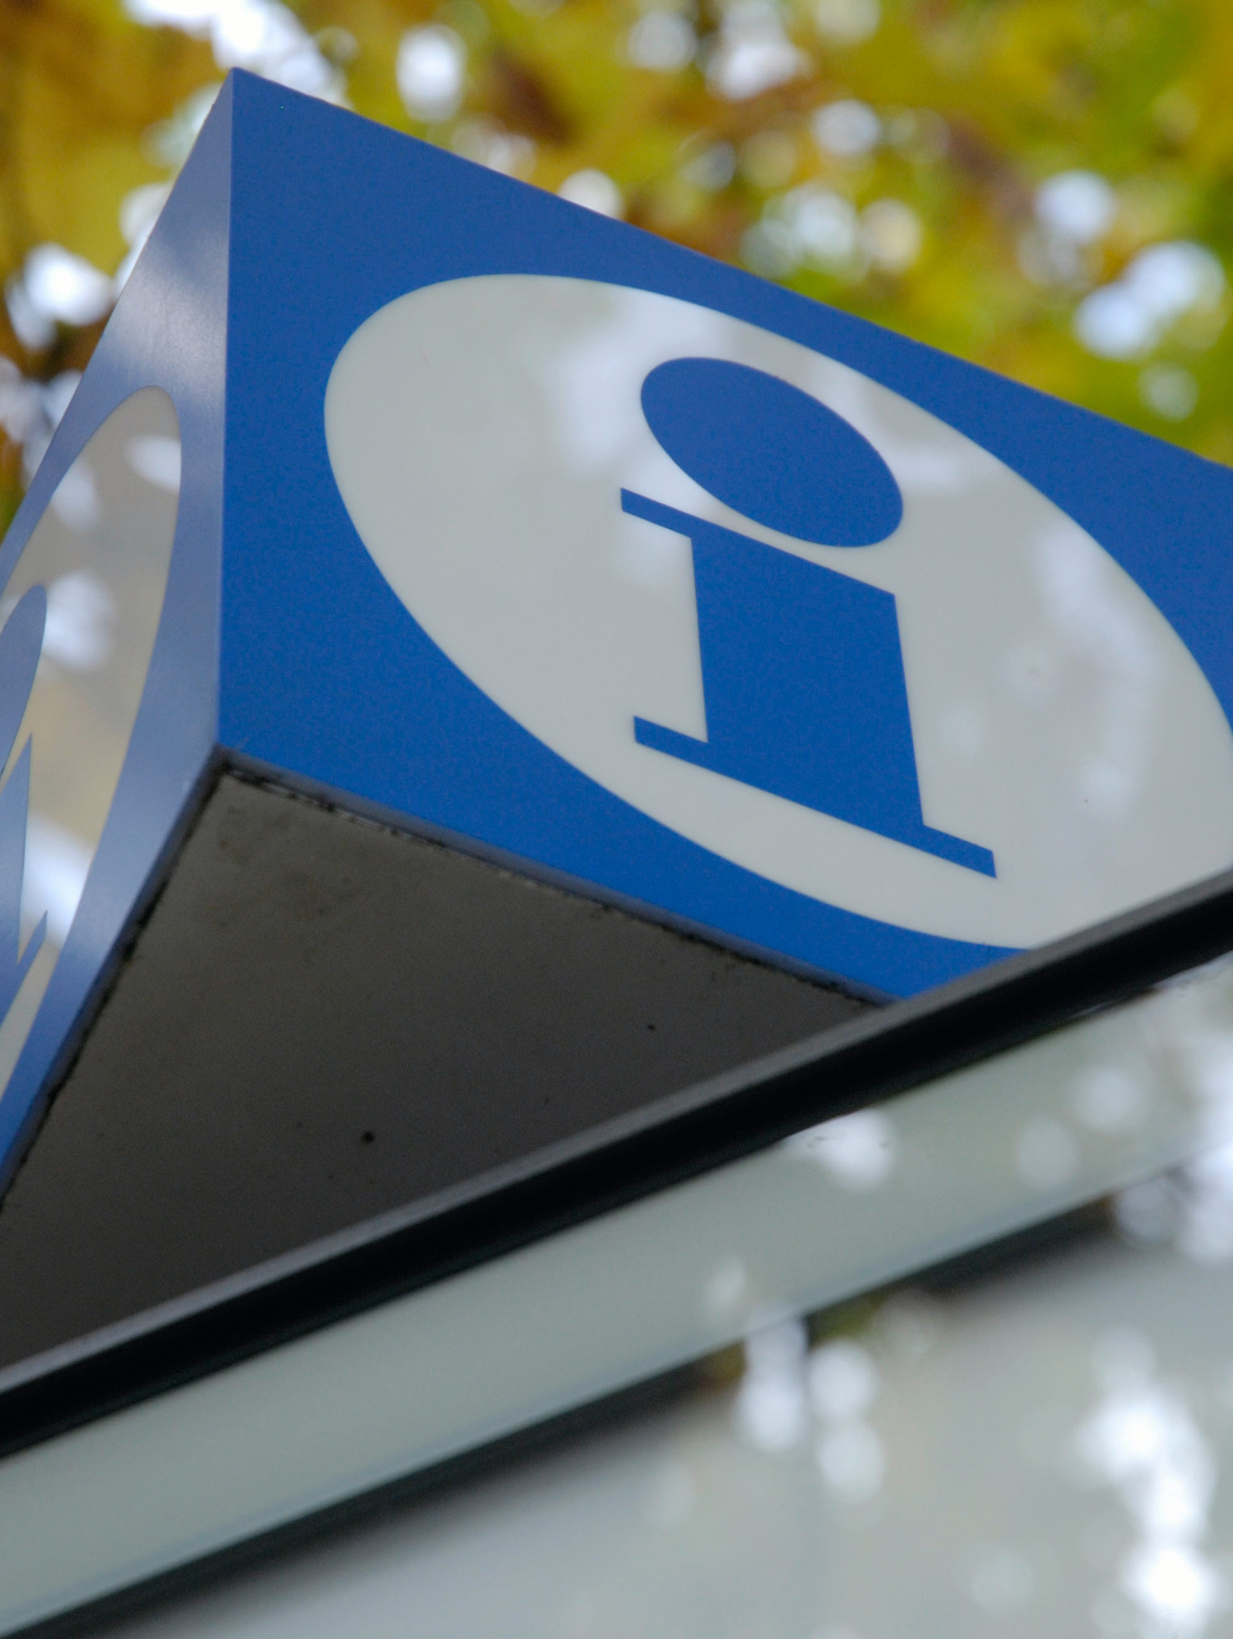
Tourist information centre/VISITOR CENTRE
Sometimes also called interpretation centres
Provides tourists with relevant information on the sites:
accommodation
maps
Tours and trails
other pertinent details related to tourism activity (Crespi-Vallbona, 2021)

Slide 11
Traditional methods
Face-to-face interactions
Guided tours and workshops
Immediate response to visitors' needs and interests
Live, current, trustworthy, and persuasive
Helps create a positive first impression of the site (Songshan et al., 2009).
Creates a suitable atmosphere to engage tourists, ensuring they are entertained and immersed in the site's history (Yamada, 2011).
Requires highly qualified interpreters and well-organized site tours, equipment, and related items for tourism activities (Crespi-Vallbona, 2021).

Slide 12
Digital technologies
Virutal reality (VR) – computer modelling and simulation that enables a person to interact with an artificial three-dimensional (3D) visual or another sensory environment (Loureiro et al., 2020).
Augmented reality (AR) – interactive experience of a real-world environment where the objects in the real world are enhanced by computer-generated perceptual information (Loureiro et al., 2020).
Mixed reality (MR) – merges the real and virtual world to produce new environments and visualisations, where physical and digital objects co-exist and interact in real-time (Speicher et al., 2019)
Digital solutions turn out to be safer and reliable (Crespi-Vallbona, 2021; Liu, 2020).

Slide 13
SUMMARY
Interpretation is nowadays based on different technologies and approaches.
They must be very well balanced and comprehensive.
Successful interpretation is critical for effective management and sustainable tourism, connecting people more profoundly with the nature environment.

Slide 14
references
Blicharska, M., Orlikowska, E. H., Roberge, J.-M., & Grodzinska-Jurczak, M. (2016, 2016/07/01/). Contribution of social science to large scale biodiversity conservation: A review of research about the Natura 2000 network. Biological Conservation, 199, 110-122. https://doi.org/https://doi.org/10.1016/j.biocon.2016.05.007
Carr, A. (2004). Mountain Places, Cultural Spaces: The Interpretation of Culturally Significant Landscapes. Journal of Sustainable Tourism, 12(5), 432-459. https://doi.org/10.1080/09669580408667248
Chang, K. C. (2014). Examining the effect of tour guide performance, tourist trust, tourist satisfaction, and flow experience on tourists' shopping behavior. Asia Pacific Journal of Tourism Research, 19(2), 219-247.
Change, C. (2019). Chapter one: Climate Change and Tourism Adaptation in Bulgaria Maria Vodenska. Research, Development and Education in Tourism, 4.
Crespi-Vallbona, M. (2021). Satisfying experiences: Guided tours at cultural heritage sites. Journal of Heritage Tourism, 16(2), 201-217.

Slide 15
references
De Rojas, C., & Camarero, C. (2008). Visitors’ experience, mood and satisfaction in a heritage context: Evidence from an interpretation center. Tourism management, 29(3), 525-537.
Dwyer, L., Edwards, D., Mistilis, N., Roman, C., & Scott, N. (2009). Destination and enterprise management for a tourism future. Tourism management, 30(1), 63-74.
Hvenegaard, G. T., Shultis, J., & Butler, J. R. (2009). The role of interpretation. Parks and protected areas in Canada: Planning and management, 202-234.
Liu, Y. (2020). Evaluating visitor experience of digital interpretation and presentation technologies at cultural heritage sites: a case study of the old town, Zuoying. Built Heritage, 4(1), 14.
Loureiro, S. M. C., Guerreiro, J., & Ali, F. (2020). 20 years of research on virtual reality and augmented reality in tourism context: A text-mining approach. Tourism management, 77, 104028.

Slide 16
references
Markham, A., Osipova, E., Lafrenz Samuels, K., & Caldas, A. (2016). World heritage and tourism in a changing climate. UNESCO Publishing.
Martini, U., Buffa, F., & Notaro, S. (2017). Community participation, natural resource management and the creation of innovative tourism products: Evidence from Italian networks of reserves in the Alps. Sustainability, 9(12), 2314.
Speicher, M., Hall, B. D., & Nebeling, M. (2019, May). What is mixed reality?. In Proceedings of the 2019 CHI conference on human factors in computing systems (pp. 1-15).
Yamada, N. (2011). Why tour guiding is important for ecotourism: Enhancing guiding quality with the ecotourism promotion policy in Japan. Asia Pacific Journal of Tourism Research, 16(2), 139–152.

Slide 17
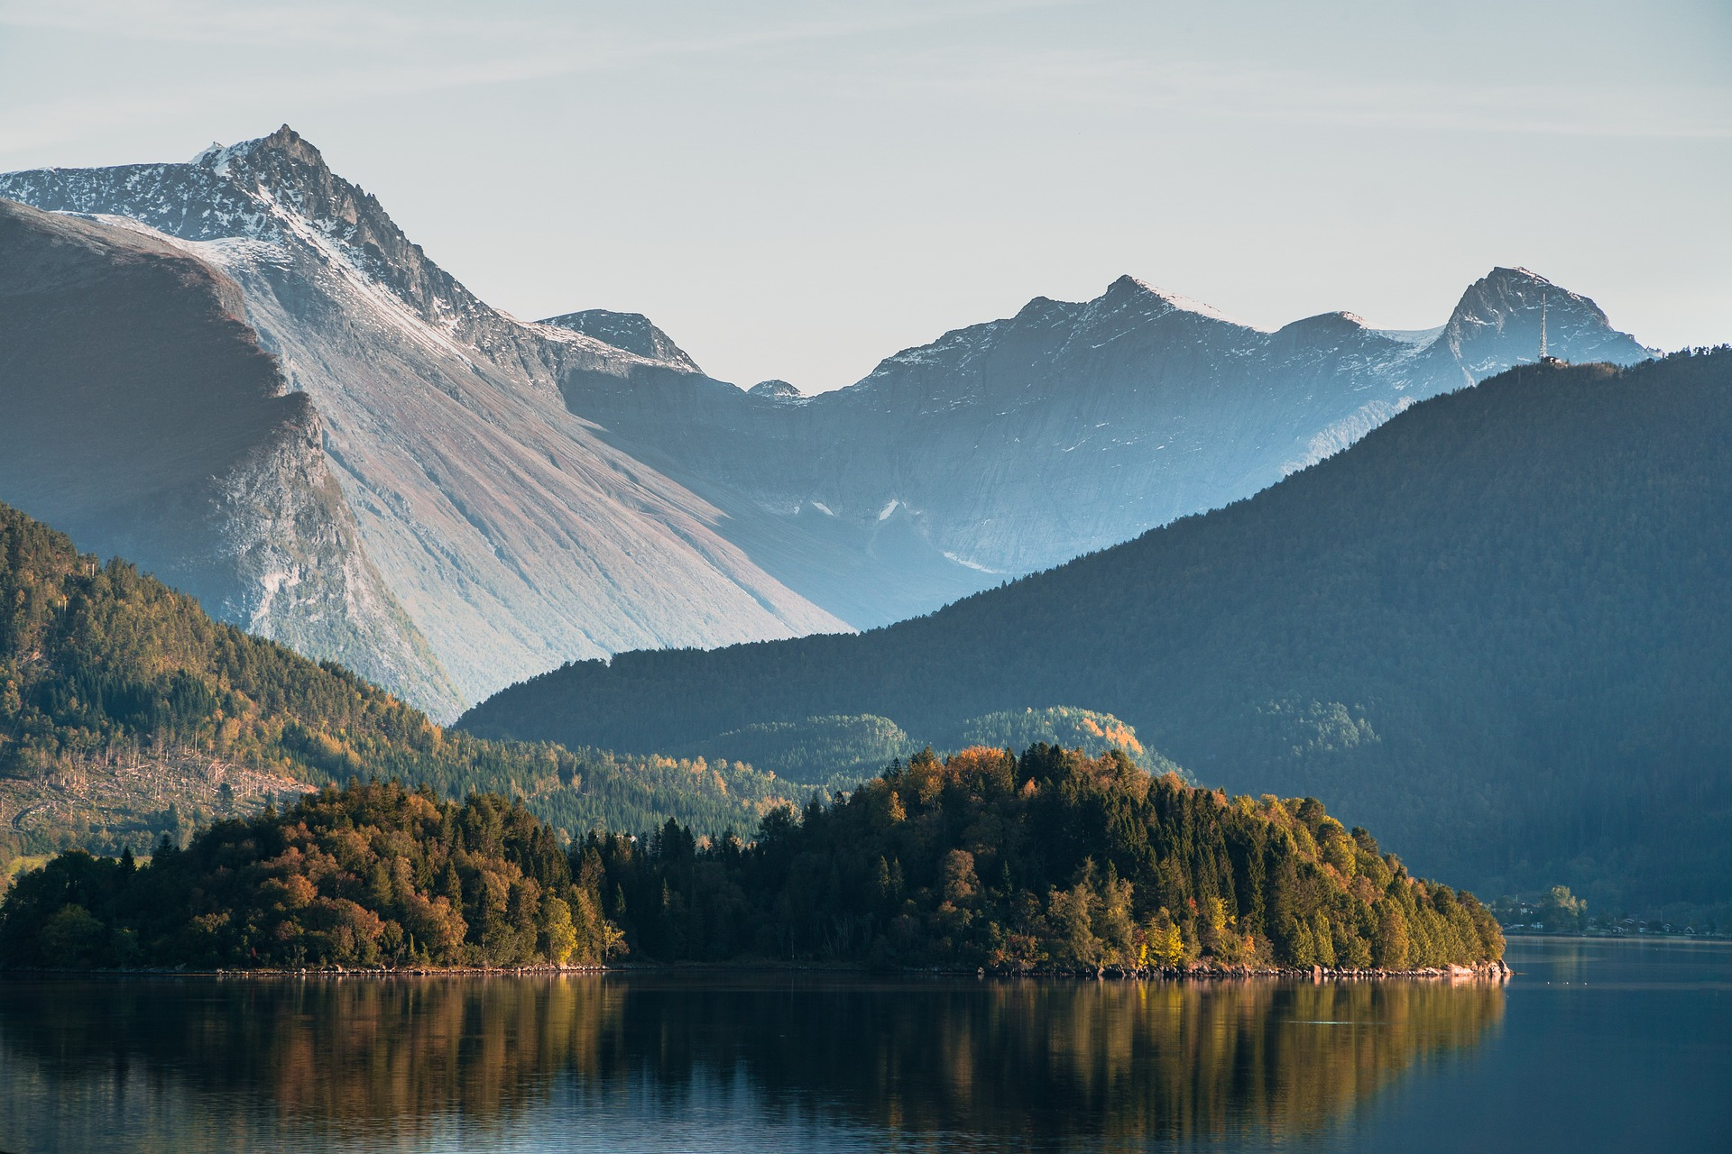
Output of the Erasmus+ K2 Strategic Partnership Project Nr. 2020-1-CZ01-KA203-078407 „Methodology of Interpretation of European Nature Heritage in Tourism" 2020 – 2023
Participating universities and their academic teams
Prague University of Economics and Business, Czech Republic;
Alexandru Ioan Cuza University of Iași, Romania;
Fachhochschule des Mittelstands, Germany;
Munster Technological University, Cork, Ireland
Universidad Europea de Madrid, Spain;
Universidade do Porto, Portugal;
University of Applied Sciences Burgenland, Austria;
Vytauto Didziojo Universitetas, Lithuania.

