Slide 1
Networking and Collaboration in Interpretation of Nature Heritage
Methodology of Interpretation of European Nature Heritage in Tourism

Slide 2
Networking and collaboration
Nature interpretation: communication approach to enhance understanding, affinity, and protection
Various communication strategies: from storytelling to advanced technological innovations
Tourism marketers challenges: creating a unique destination image/brand and positioning strategy
Internet and Web 2.0 make it increasingly difficult (Pike, 2016)
Overcoming challenges: development of destination network/organisation and branding
Key concept: to reach target market efficiently through destination branding

Slide 3
Destination network
Destinations = diverse amalgamation of different variables in which some or all of the businesses involved appeal to the target market
The success of a business within the destination depends on the success of the destination itself (Pike, 2004)
The benefits to the individual businesses of forming destination networks and brands seems evident
Diversity of the tourism product
Complexity of the tourism product
Diverse characteristics of the tourists

Slide 4
Communicating the message
Multiple stakeholder groups working together
The main aim is to help visitors respond to the beauty of the destination, the importance of its history, and its cultural significance
This might evoke emotions, imaginations, stories and personal experiences
Developing a network of stakeholders to promote the local nature heritage resources
A growing share of the market that will not endure over-developed tourism destinations (Ruhanen, 2007)

Slide 5
Tourism network
Network = a group of interconnected businesses, providing access to resources such as knowledge, power, and capital (Elfring & Hulsink, 2003; Grandori & Soda, 1995).
Networks are dynamic and constantly evolving.
They provide companies with a medium for organising their business relationships to improve their competitive position (Jarillo, 1998)
The main benefit of a network structure: learning and Exchange of good prectice allow for mutual benefits for network actors (increased business activity)
The tourism network permits different stakeholders to work together

Slide 6
Benefits of networks
Access to inter-organisational learning and knowledge sharing
Companies can respond better to market changes
A singular message is communicated to potential visitors, thus forming an accurate perception of that destination

Slide 7
Types of networks (Based on the example of Ireland)
International networks
UNWTO
National networks
Fálite Ireland
Sector-based networks
composed of actors who come together to promote a particular offer or area of interest
Community networks
Burren Eco Tourism & Geopark network in Ireland
composed of local stakeholders who work together
Networks can also be relatively simple – individuals work together for a common purpose.
Volunteering networks – quite common in tourism, play a crucial role in sustainable tourism and rural development

Slide 8
branding
„Simply a collection of perceptions held in the minds of the consumers“ (Fournier, 1998).
Destination branding – communication of destination benefits to potential tourists; helps interpret the nature heritage.
The relevance of the brand is associated with the perception held of that brand by the consumer.
Tourists form expectations about a destination based on previous experiences, word of mouth, or marketing.
Provides a level of familiarity, allows to make informed decisions, reduces risks associated with the purchase.
Particularly relevant when purchasing an intangible product (typical for heritage tourism).

Slide 9
Branding key elements
Brand identity
the image desired by the organisation
Brand image
the actual image in the minds of the consumers
Brand positioning
the strategy by organisations to decrease a gap between brand identity and brand image (Pike, 1996)

Slide 10
DESTINATION BRANDING
Brand identity derived by the producer & brand image as the actual perception of the destination in the minds of the consumers (Aaker, 1996).
Seeks to ensure the intended image matches the actual image.
The brand identity will often be the first encounter a potential tourist has (prior to deciding to visit a tourism heritage site).
Destination branding is crucial for offering a quality tourism experience and disseminating it after the visit (Ritchie and Ritchie, 1998).
Accurate marketing communications strategy is essential.

Slide 11
Brand and destination image
Destination branding plays an important role in tourism decision-making.
Brand image is subjective and varies according to individual experiences.
Developing a brand identity is a challenge for destination marketers (Pike, 1996).
Destination image is the result of individual perceptions and the holistic impressions of a destination (Echtner and Ritchie, 1991).
There is a strong correlation between destination image and destination loyalty.

Slide 12
Role of branding in heritage interpretation
„Heritage interpretation helps visitors make sense of, understand and emotionally attach themselves to the destinations they visit and the events they experience“ (Robertson, 2015).
Co-creation as a key element
The development of a good interpretation plan can result in the positive perception of a particular site as a quality experience resulting in positive word of mouth and social media communications (Robertson, 2015).
Destination loyalty
Heritage interpretation should be a crucial part of the marketing plan

Slide 13
Tourism experience
Experience = „a noun and a verb used variously to convey the process itself, participating in the activity, the affect or way in which an object, thought or emotion is felt through the senses or the mind, and even the outcome of an experience by way of a skill or learning…“ (Tynan & McKechnie, 2009)
Crucial element: each one is unique
Customer = the creator of the experience X organisation = the delivery of that experience
Heritage sites need to differentiate and provide a clear image and identity in order to be recognised favourably by the target market = branding

Slide 14
contradictory behaviour of tourists
The interpretation plan can provide a tool for the different voices of sustainability that tourist personify:
1/3 of European citizens consider sustainable practices important for their holidays.
Many nature tourists present inconsistent behaviour in ther nature visits.
They show pro-environmental attitudes in some instances.
On the other hand, they ignore a sustainability mindset in others situations (Kim & Weiler, 2013).

Slide 15
Brand loyalty
Enhanced experiences are said to attract more visitors, support longer stays, bring benefits to destination community, increased revenues, which in turn can contribute to brand loyalty.
Brand affinity emerges from the tourist’s emotional attachments to the experience.
Interpretation must incorporate differences into interpreted experiences, provide personal connections for visitors, encourage hands-on interactions, create clear content, and allow for different audiences (Mocardo, 1999).

Slide 16
The process of Creating a brand
Understanding
visitors’ needs, expectations and interpretation preferences to keep them engaged
Exploring
how visitors create their own meanings of places and heritage over extended periods
Measuring
the effectiveness of interpretation

Slide 17
Summary
Key elements of network formation in tourism and branding tourism destinations
Key correlation between the development of a tourism network and branding of a destination
Purpose of network collaboration is to brand destination as a single entity
Branding is essential in tourist decision-making process
Networks involve industry stakeholders, community stakeholders, public/private organizations

Slide 18
references
Aaker, D. A. (1996). Building Strong Brands. New York: Free Press.
Echtner, C. M. and Ritchie, J. R. B. (1991). The meaning and measurement of destination image. The Journal of Tourism Studies 2(2): 2–12.
Elfring, T. & Hulsink, W. (2003). Networks in entrepreneurship: The case of high technology firms. Small Business Economics 21(4): 409-422.
Fournier, S. (1998). Consumers and Their Brands: Developing Relationship Theory in Consumer Research. Journal of Consumer Research 24(4): 343–53.
Jarillo, J.C. (1988). On Strategic Networks. Strategic Management Journal 9(1): 31-41.
Kim, A.K.J., (2012). Determinants of tourist behaviour in coastal environmental protection.
Pike, S. (2016). Destination Marketing, 2nd Edition. London and New York, Routledge.

Slide 19
references
Ritchie, J. R. B. (1998). The branding of tourism destinations: Past achievements and future challenges. In Keller, P. (ed.) Destination Marketing: Reports of the 48th AIEST Congress, Marrakech, pp. 89–116.
Robertson, M., (2015). Heritage interpretation, place branding and experiential marketing in the destination management of geotourism sites. Translation Spaces 4(2): 289-309.
Ruhanen, L. (2007). ‘Destination competitiveness: Meeting sustainability objectives through strategic planning and visioning’, In Advances in Modern Tourism Research, Matias, A., Neto, P. & Nijkamp, P. (eds.), Physica-Verlag: Heidelberg, pp. 133-151.
Tynan, C. and McKechnie, S. (2009). Experience marketing: a review and reassessment. Journal of Marketing Management 25 (5-6): 501-517.
Van der Zee, E., & Vanneste, D, (2015), Tourism networks unravelled; a review of the literature on networks in tourism management studies, Tourism Management Perspectives, 15: 46-56.

Slide 20
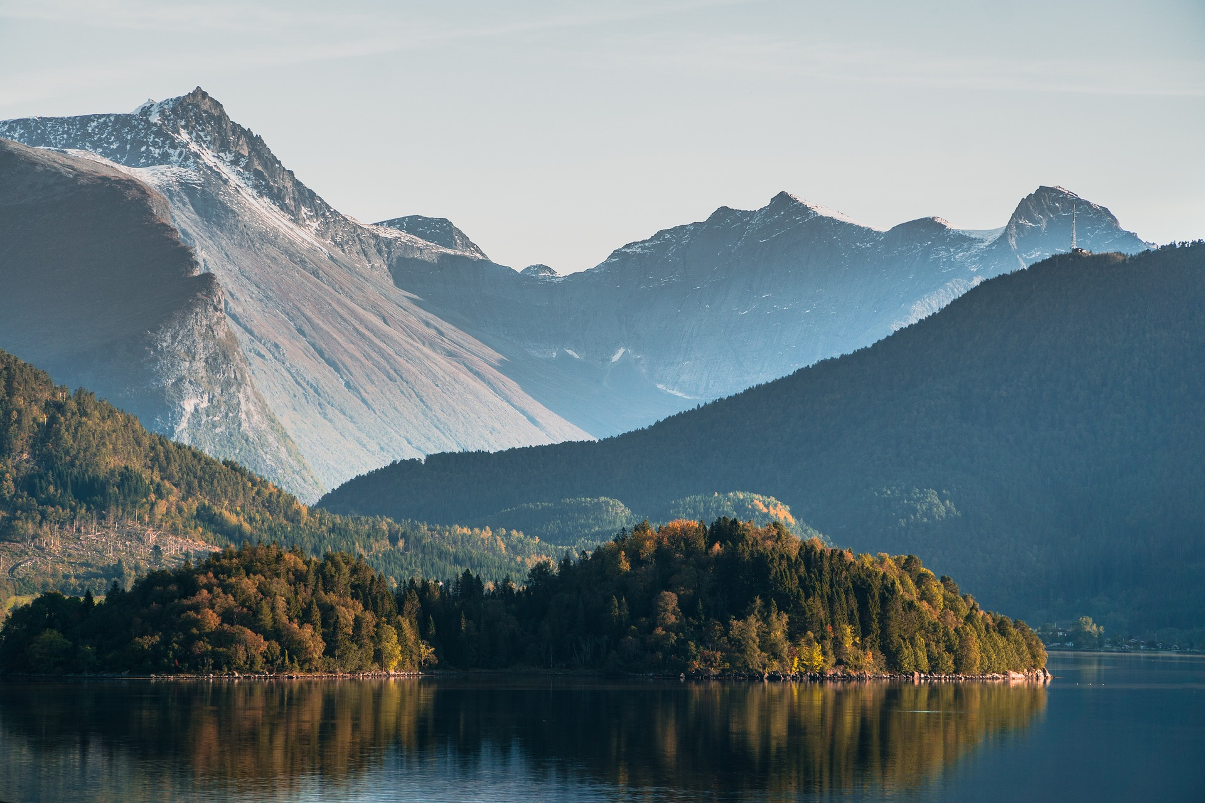
Output of the Erasmus+ K2 Strategic Partnership Project Nr. 2020-1-CZ01-KA203-078407 „Methodology of Interpretation of European Nature Heritage in Tourism" 2020 – 2023
Participating universities and their academic teams
Prague University of Economics and Business, Czech Republic;
Alexandru Ioan Cuza University of Iași, Romania;
Fachhochschule des Mittelstands, Germany;
Munster Technological University, Cork, Ireland
Universidad Europea de Madrid, Spain;
Universidade do Porto, Portugal;
University of Applied Sciences Burgenland, Austria;
Vytauto Didziojo Universitetas, Lithuania.

