Slide 1
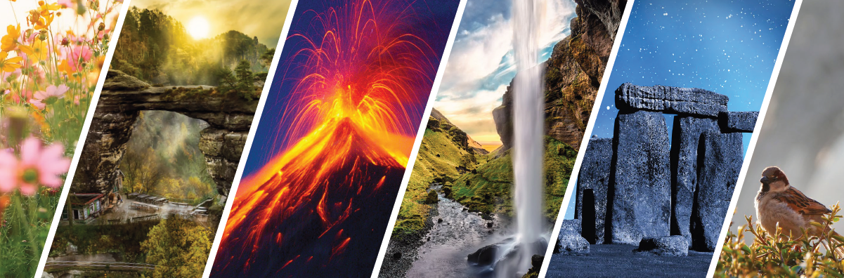
Specifics of Interpretation in Different Types of Nature Attractions
Methodology of Interpretation of European Nature Heritage in Tourism

Slide 2
1 CAVES
Methodology of Interpretation of European Nature Heritage in Tourism

Slide 3
Caves definition
Caves provide insights into Earth‘s evolution and human communities
Defined as natural cavities in total darkness
Criteria for a cave: natural formation, large enough for human entry, total darkness
Caves result from erosion in susceptible rock formations
Presence of caves depends on abundance of soluble rocks

Slide 4
Types of caves
1) Solution caves
Water seeps, dissolves calcium carbonate
2) Lava caves
Result from volcanic eruptions, evacuated lava flows
3) Sea caves
Water erosion on karst or pseudo-karst surfaces
Forms broad passageways, extensive drainage systems
Example: Postojna Jama (Slovinsko), Javořické caves, Moravský kras, Koněprusy (CZ)
Vacuum creates tube caves
Example: „fire tubes“ in La Palma (Canary Islands)
Spectacular caves along the coastline
Example: France

Slide 5
Types of caves
4) Ice caves
Develop in glacier landscapes with thawing and water streams
5) Aeolian or wind caves
Wind erosion in desert areas against rocks
6) Talus caves
Accidental formation from falling rocks
Some accessible but generally unstable
Example: Arizona desert caves
Example: České Švýcarsko (CZ), Sächsiche Schweiz (GE)
Example: Dämenovska (Slovakia), Mammuthölle, Tuxer Gletscher (A), Ice pavillon Saas Fe (Switzerland)

Slide 6
definitions
Geo-tourism – a type of natural area tourism focusing on geology and landscape
Geo-tourist – undertakes geo-tourism, wants to learn about the site‘s features (Allan, 2012)
Sustainable geo-tourism – involves an attempt to create sustainable tourism formats
Speleology – scientific discipline concerned with all aspects of caves and cave systems
Speleo-tourism/cave tourism – activities covering a variety of cave tours
Geo-ethics – a scientific focus on the interaction of human beings with the Earth‘s natural systems, investigating the impacts of these interactions, providing reflections on what is appropriate behaviour in such situa

Slide 7
Recreational Use of caves
Tourists are attracted to caves for their natural beauty, educational purposes and recreational or adventure purposes
Cave tourism contributes to regional development and environmental awareness
Proper management of caves is crucial for their economic, environmental, and social benefits
Concerns exist regarding the impact of recreational cave tourism on the caves and their surrounding environment
Various activities, such as caving, spelunking, speleology, cater for different interests and levels of exploration

Slide 8
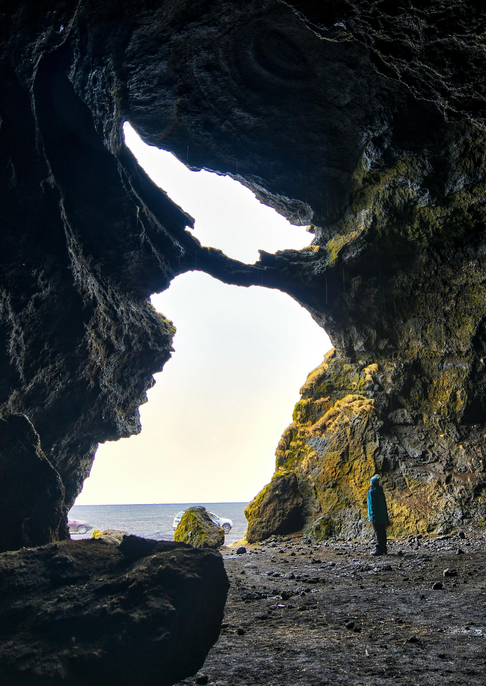
Show caves
Open to the general public
Require infrastructure development and trained guides for visitor education and cave preservation
Significant geo-tourism targets, attracting millions of visitors annually
Providing economic resources, particularly for less developer areas
Now used for diverse activities beyond tourism, including corporate presentations, weddings, dining, and concerts
Cigna and Burri (2000)

Slide 9
Factors affecting the development and operation of a tourist cave
Scientific investigation
Art
Technology
Management
Gurnee & Gurnee (1981)

Slide 10
Elements to consider when developing and managing show caves
Preliminary evaluation for the development of the cave
Calculation of the visiting capacity of a tourist cave („visitor carrying capacity“) (Lobo, 2015)
The sources of disturbance to the cave environment are those factors that modify the natural equilibrium of the cave environment
Environmental impact assessment (EIA) for the cave should be caried out

Slide 11
Scientific research importance
Rock shelters and caves offer valuable information about the weather conditions that different human species and communities faced
Archaeological remaints in caves offer a glimpse into the social composition and organizational aspects of human communities
Burials in caves provide evidence of religious beliefs and social categorization
The study of caves initiates actions for environmental conservation and undestanding environmental degradation

Slide 12
Carrying capacity and key problems
Determining an effective carrying capacity is challenging and requires consideration of factors such as cave size, atmospheric characteristics, and fragility of cave features
Balance between the number of visitors and the time needed for the cave to recover its atmospheric conditions
Should also consider the time limits and visitor capacity at interpretation points along the route
Adjusting visitation frequency, routes, interpretative stops, or opening hours to allow for sufficient recovery time

Slide 13
Key stakeholders
EU initiatives for cave preservation
01
Member states‘ registry and action
02
Compliance with European legislation
03
Categorization of sites according to UNESCO guidelines
04
Importance of local authorities‘ role
05
(Ministerio de Cultura y Deporte, 2022; Ministerio de Asuntos Exteriores, Unión Europea y Cooperación, 2022)

Slide 14
Segmentation of tourist visitors
Lack of comprehensive understanding of visitors motivations in geo-tourism
Segmentation based on recreational and educational purposes: escape-seekers, knowledge and novelty seekers, novelty-seekers, and socializers (Kim et al, 2008)
Segmentation based on motivation:
Study: Allan & Dowling (2015) – relaxation, escape, sense of wonder, knowledge
Study: Shavanddasht et al. (2017) – enjoyment, relaxation, novelty seeking, escape, socialization, knowledge

Slide 15
Principal types of interpretation
Mission-based communication process connecting audience interests with resource meanings
Core philisophy: interpretation leads to understanding, appreciation, and protection
Modern roles of interpretation: personal and non-personal
Personal – physical interaction with visitors (tours, talks, demonstations, etc.)
Non-personal – self-guided exploration (exhibits, printed materials, signs, brochures, audio/visual devices), new technologies for interactive experiences

Slide 16
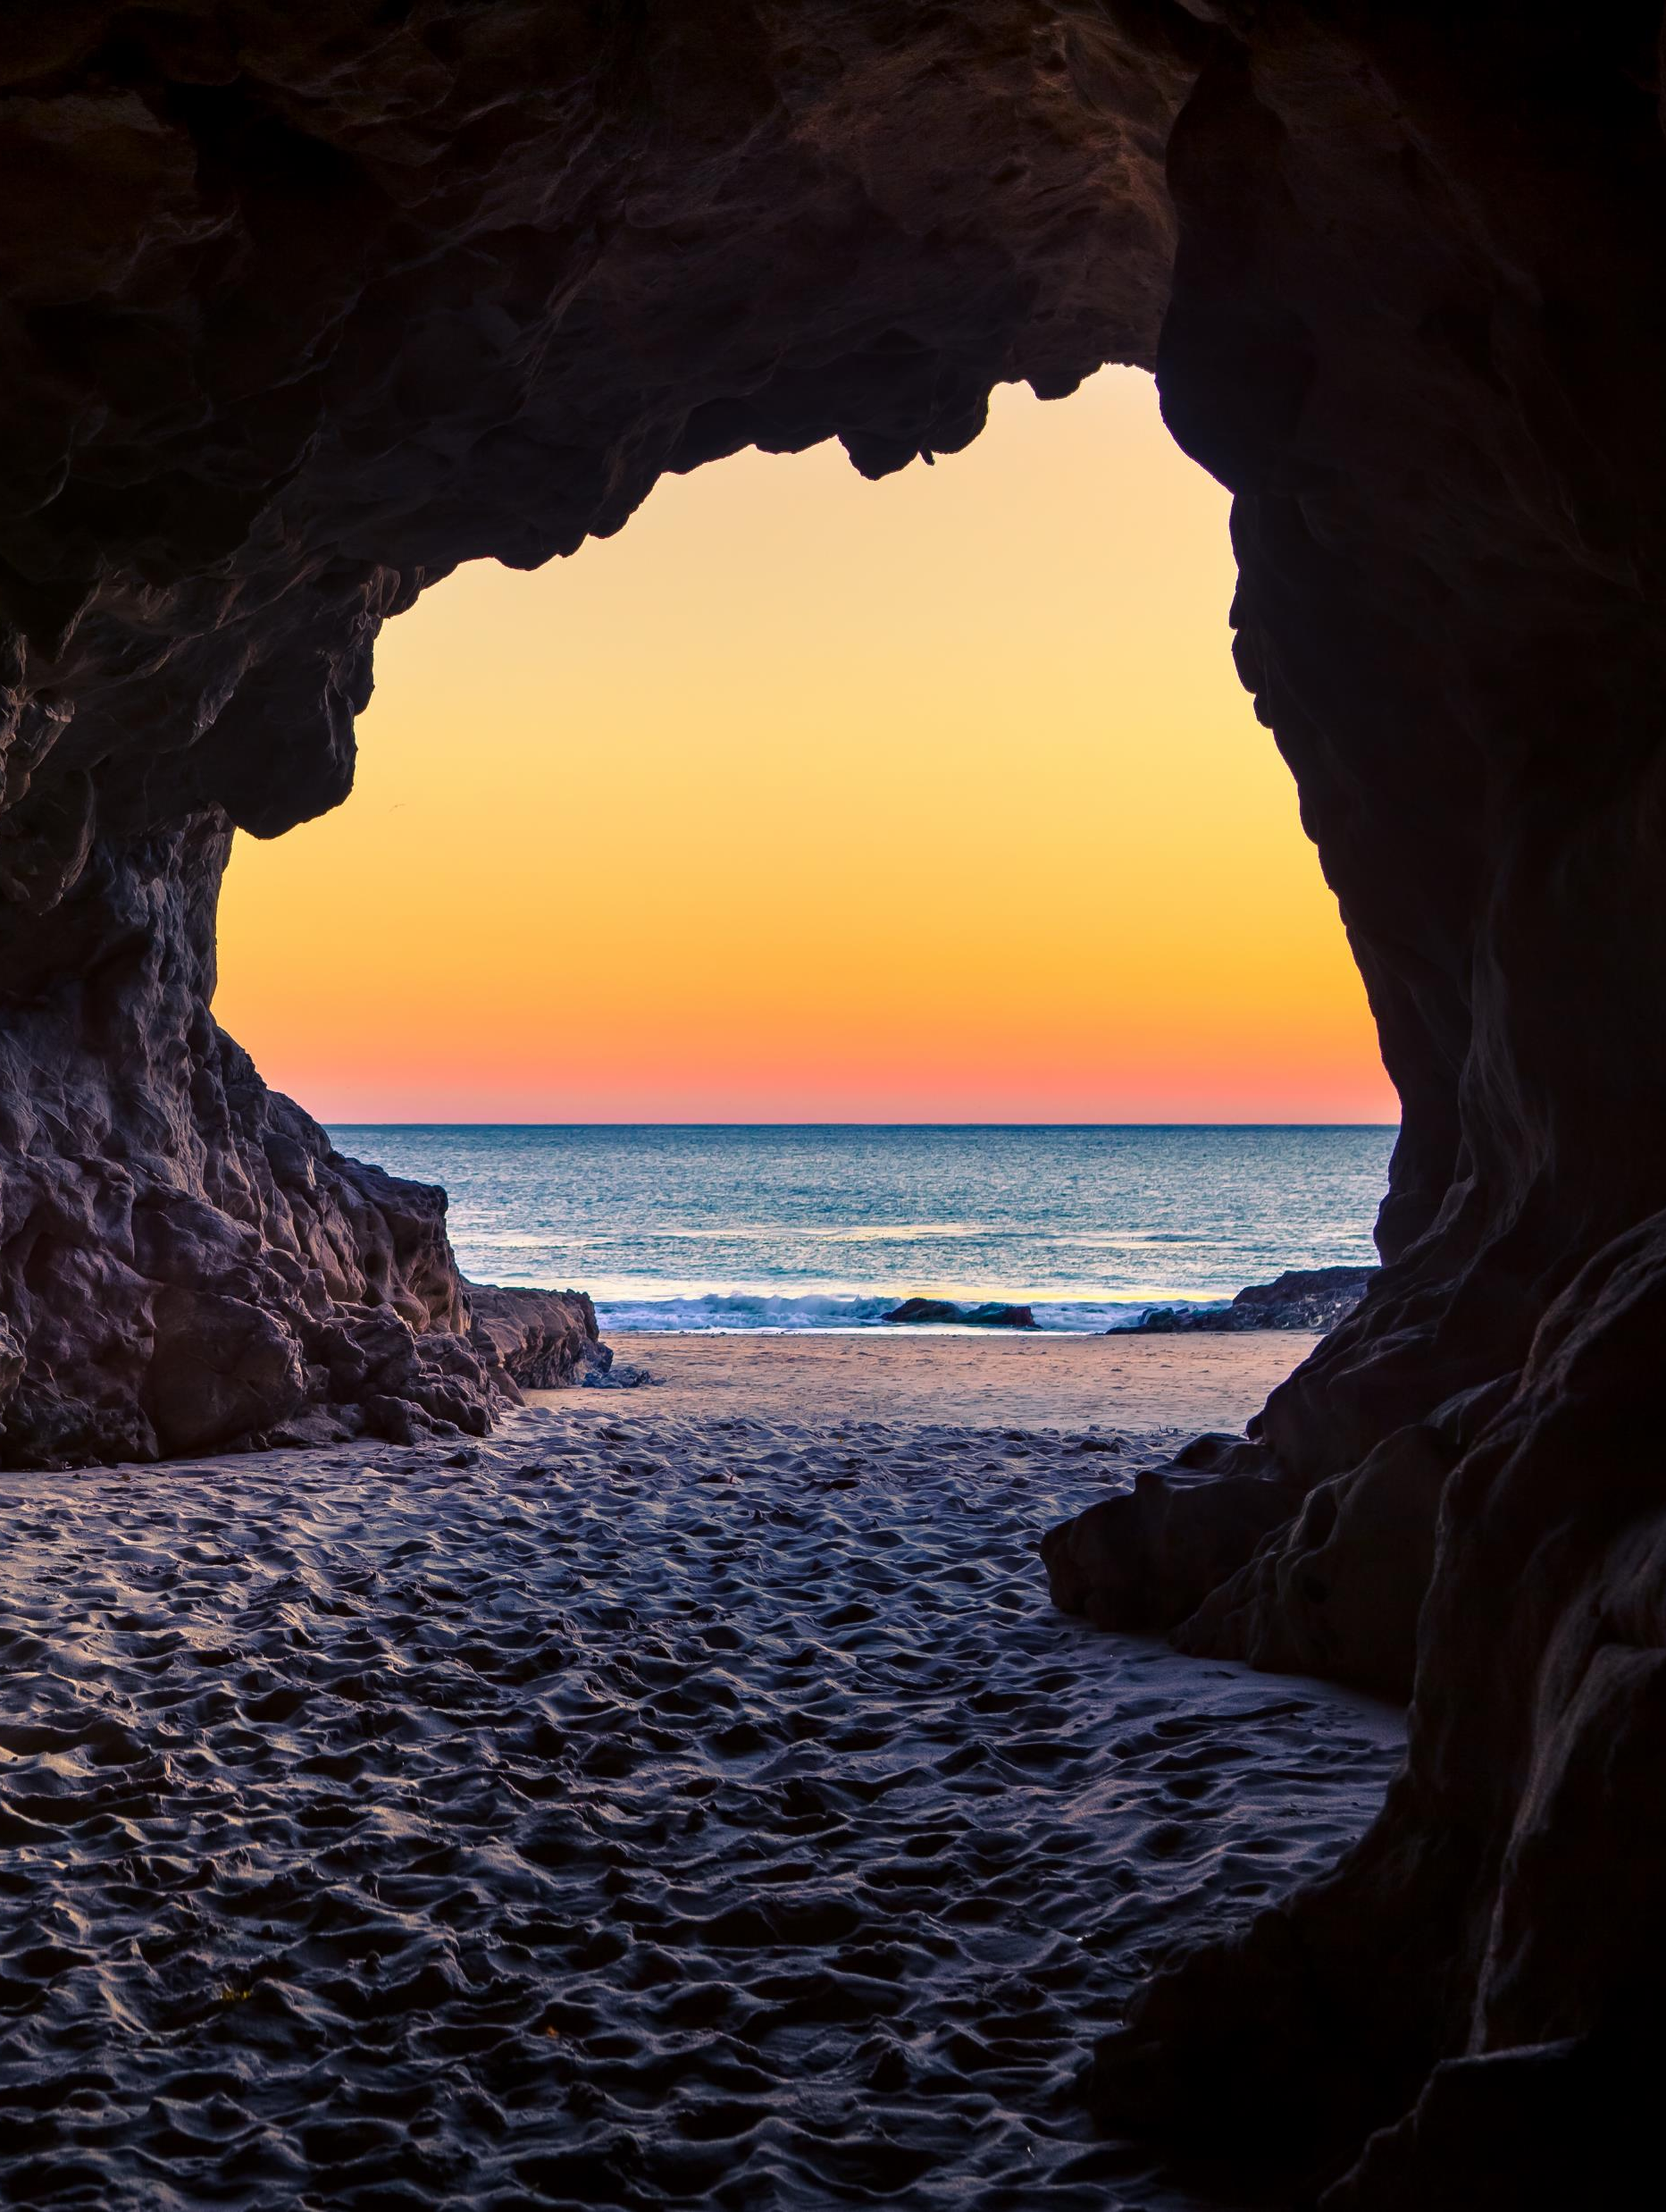
Personal interpretation: cave guided tours
Guides play an important role in the visitor‘s experience since they are the main source of information and interpretation
Personal guided tours are preffered for a better and more complete experience
Cave tour guides ensure visitor security, point out hazards, prevent visitors from getting lost, and prevent visitor´s misbehaviour (e.g. touching and breaking stalagmites)
Manage groups and maintain harmony during cave visits
Provide educational knowledge in variour disciplines
Act as guardians of the cave‘s environment
Effectively present ideas, explain complex concepts, and adapt to different situations

Slide 17
Key principles of successful guided cave interpretation
Visitor enjoyment
Relevance to the audience and site
Organizing
Key theme
Group management
Protection
Two-way communication
Holistic approach
Emotion
Davidson & Black (2007)

Slide 18
Non-personal interpretation
Visitors interact autonomously without an interpreter
Common methods: printed information sheets, brochures, signs, audio/visual devices
Perceived as offering lower quality interpretation and overall satisfaction
Value of non-personal methods lies in visitor‘s ability to adapt their use to their needs
Fragility and non-renewability of cave heritage require conservation and sustainable development
Public use: connecting visitors with natural and cultural values, ensuring conservation, providing information, education, and interpretation

Slide 19
Examples of good practice The caves of Artà (Mallorca, Spain)
Geological formation of limestone origin
Limited number of entry tickets for preservation and exclusivity
Creative and accurate lighting enhances the beauty of formations
Visit in groups with flexible timetable

Slide 20
Examples of good practice La cueva de pozalagua (Bizkaia)
Well preserved with unique stalactities
Concentric stalactites create impressive shapes and figures
Visists in groups, metal walkway inside with handrails
Expert guide provides explanation

Slide 21
summary
Differences between types of caves
Proper management of caves is crucial for their economic, environmental, and social benefits
Carrying capacity calculation
Key principles of cave interpretation – personal and non-personal interpretation

Slide 22
references
Cigna, A. A. (2016). Tourism and show caves. Zeitschrift für Geomorphologie, 6(1), 9-26.
Cigna, A. A. (2016). Tourism and show caves. Zeitschrift für Geomorphologie, 60(2), 217-233.
Kim, S. S., Kim, M., Park, J., & Guo, Y. (2008). Cave tourism: Tourists’ characteristics, motivations to visit, and the segmentation of their behaviour. Asia Pacific Journal of Tourism Research, 13(3), 299-318.
Lobo, H.A.S. (2015). Characterization and management trends of negative and positive impacts of tourism in show caves. Revista Brasileira de Pesquisa em Turismo, 9(2).

Slide 23
references
Ministerio de Asuntos Exteriores, Unión Europea y Cooperación (2022). Patrimonio Mundial>Inscripciones UNESCO. Madrid: Gobierno de España. Retrieved from: http://www.exteriores.gob.es/RepresentacionesPermanentes/unesco/es/unescoenespa%C3%B1a/Inscripciones/Paginas/PatrimonioMundial.aspx (last access on 31-1-2022).
Ministerio de Cultura y Deporte (2022). ‘Anexo 3. Normativa reguladora para la protección de bienes culturales de ámbito europeo’. Madrid: Gobierno de España. Retrieved 31 January 2022, from: https://www.culturaydeporte.gob.es/planes-nacionales/dam/jcr:82e29b9f-21ac-4e88-81cd-20af953ca0d5/normativa-reguladora-para-la-proteccion-de-bienes-culturales-de-ambito-europeo.pdf

Slide 24
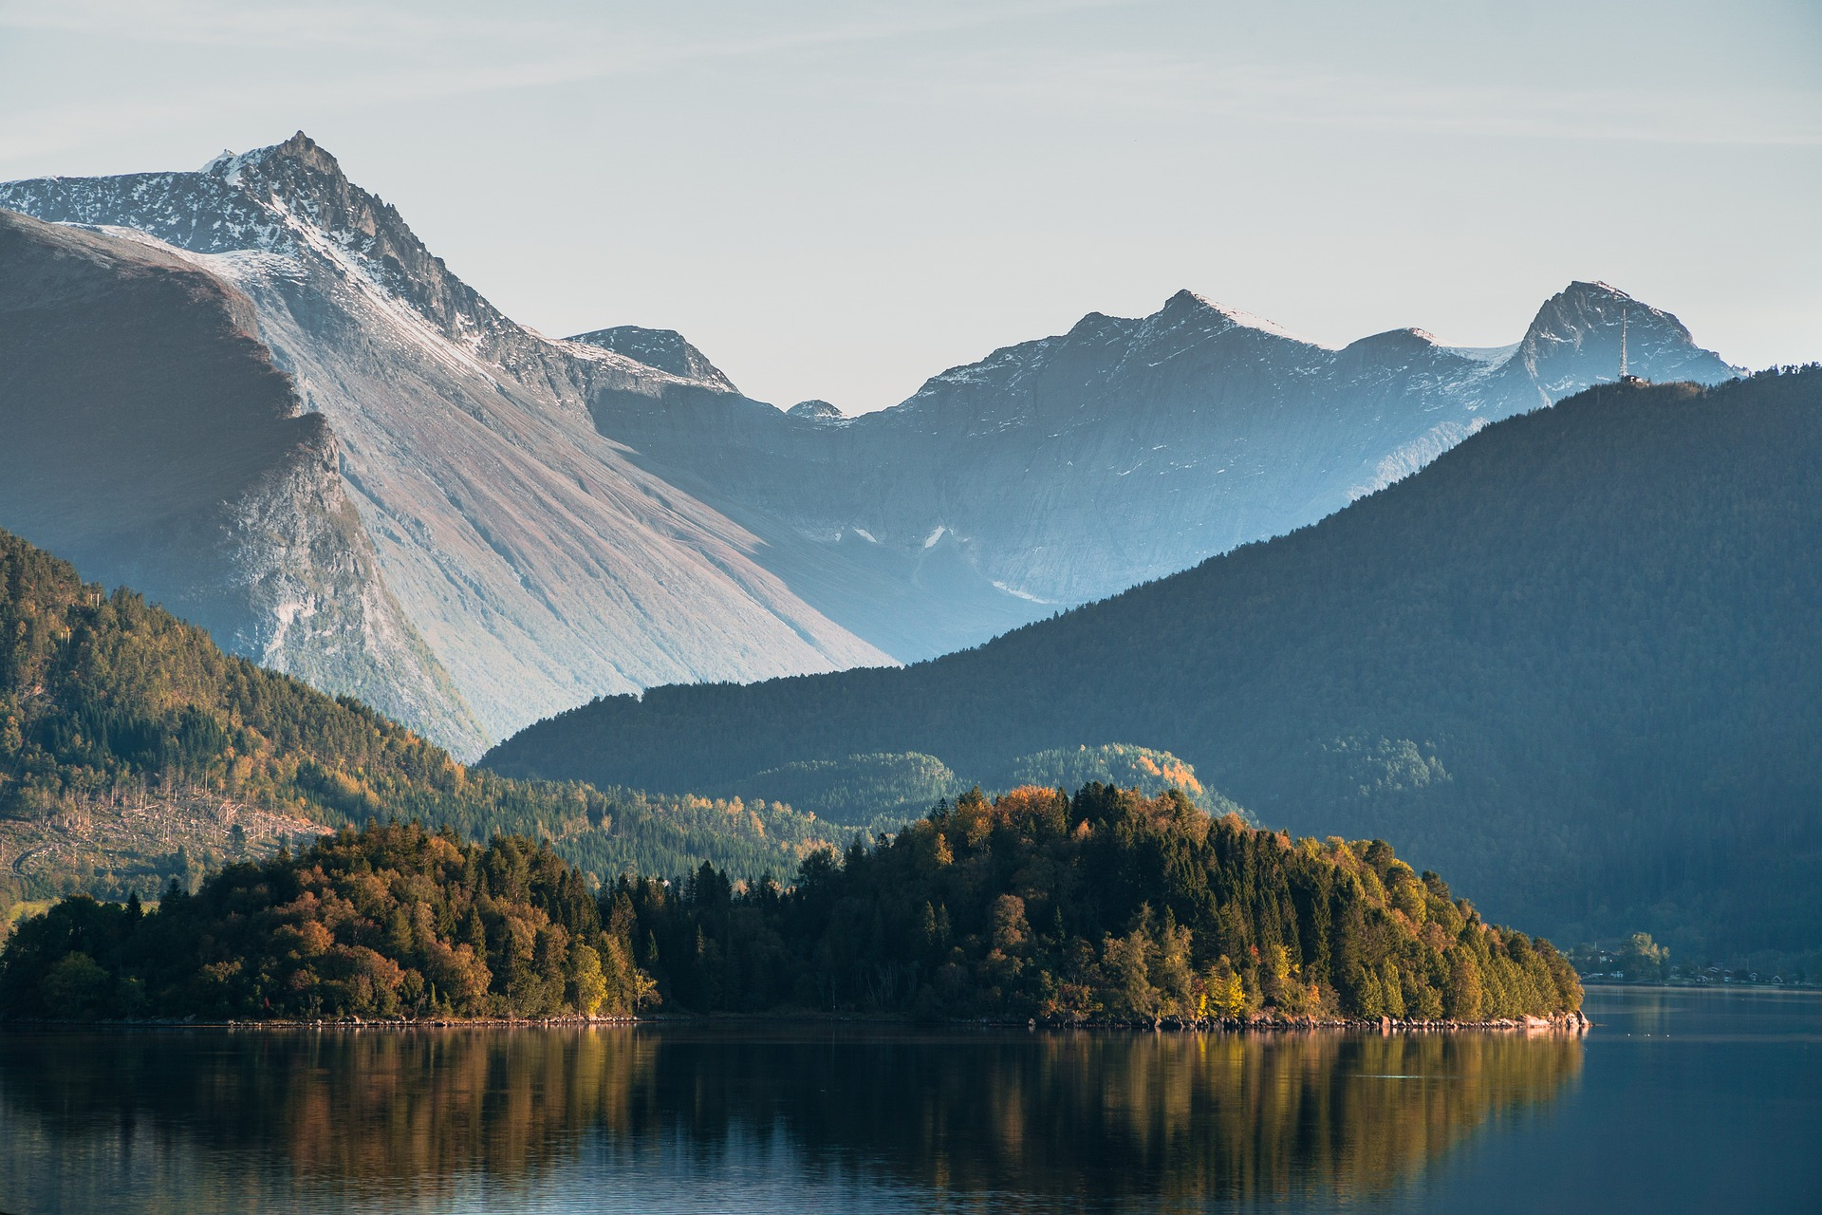
Output of the Erasmus+ K2 Strategic Partnership Project Nr. 2020-1-CZ01-KA203-078407 „Methodology of Interpretation of European Nature Heritage in Tourism" 2020 – 2023
Participating universities and their academic teams
Prague University of Economics and Business, Czech Republic;
Alexandru Ioan Cuza University of Iași, Romania;
Fachhochschule des Mittelstands, Germany;
Munster Technological University, Cork, Ireland
Universidad Europea de Madrid, Spain;
Universidade do Porto, Portugal;
University of Applied Sciences Burgenland, Austria;
Vytauto Didziojo Universitetas, Lithuania.

Slide 25
2 large-scale Protected areas and national parks
Methodology of Interpretation of European Nature Heritage in Tourism

Slide 26
Protected areas
„Protected area is a clearly defined geographical space, recognised, dedicated and managed, through legal or other effective means, to achieve the long-term conservation of nature with associated ekosystem services and cultural values“ (Dudley, 2008).
„Large-scale protected area“ (LSPA) – national parks, UNESCO biosphere reserves, nature and landscape parks, including also UNESCO World Heritage Sites (depending on their size and objectives)

Slide 27
The iucn protected area categories system
Strict nature reserve
Wilderness area
National park
Natural monument or feature
Habitat/species management area
Protected landscape/seascape

Slide 28
Natura 2000
A network of large-scale protected areas established by the European Union with the aim of permanently securing Europe‘s habitats
Covers 18 % of the EU‘s land mass and more than 8 % of its marine territory
Aiming to protect rare species and habitats while promoting conservation and sustainable use

Slide 29
European large-scale protected areas and national parks
National park is a protected area which is operated primarily for ecosystem protection and recreational purposes (IUCN, 2018).
The primary objectives of a national park:
Banning partial areas from any human use or exploitation activities
Undertaking active maintenance and conservation measures
Supporting scientific research
Providing visitors with authentic experiences

Slide 30
Specifics of heritage interpretation
Modern interpretation of natural heritage based on principles by Freeman Tilden
Heritage interpretation aims to reveal meanings and relationships through original objects, first-hand experience, and illustrative media
Interpretation should involve, provoke, and be oriented towards the target audience
Tilden‘s principles are still relevant and form the basis of modern heritage interpretation

Slide 31
Tilden‘s principles
Interpretation must relate to the visitor‘s personality or experience to avoid being sterile
Interpretation is relevation based on information
Interpretation is an art that combines various arts and can be taught
The main goal is to provoke
Interpretation should present a holistic perspective and engage the whole person
Interpretation for children requires a different approach and should have a separate program

Slide 32
cALANQUES national park, france Examples of good practice
Field agents (e.g. coastal wardens, eco-wardens, regional forest wardens) are all trained not just to manage, preserve and monitor compliance with regulations, but also to interpret and inform.
Wardens volunteer programme
Heritage interpretation scheme
Educational activities (e.g. “Plastic Pirates”, “The Éducalanques Education Network”)
“Calanques Autumn Festival” as an off-season cultural activity
“Diving into the heart of the canyons” programme — a mix of physical exhibition and digital material available online

Slide 33
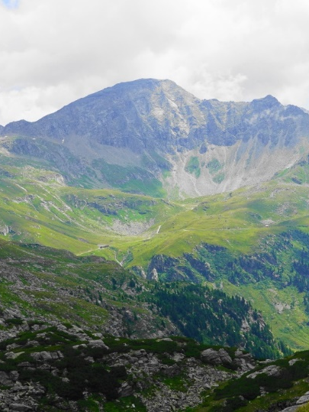
Hohe tauern national park, austria Examples of good practice
Three main visitor centres, among them the largest national park visitor centre in central Europe
Science centres with a focus on natural sciences
Themed guided tours: primeval forests, glaciers, mountain herbs, lakes, game watching, bird watching, geology
Educational programmes for schools (e.g. junior ranger programmes, summer camps, “Climate School”, “Water School”)
Scientific programmes with a focus on park management, bio- and geodiversity, archaeology
“Rent a ranger” for groups and individual tours

Slide 34
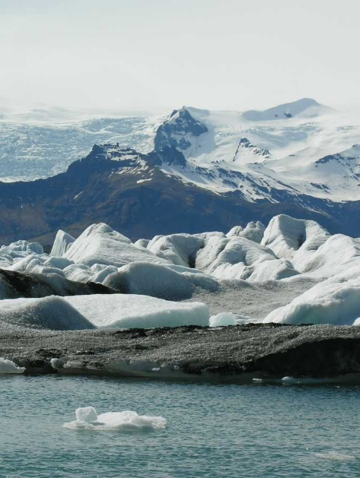
Vatnajökull national park, iceland Examples of good practice
Five main visitor centres, each equipped with a souvenir shop offering a range of local craftsmanship and cultural heritage items
Each of the seven areas of the park offers guided tours of different lengths and on different topics
Extensive hiking trail net, including extensive map material both in print and digital versions
“Melting Glaciers” scientific project with a focus on glaciology encompassing both scientific research and popular science dissemination

Slide 35
Schleswig-holstein wadden sea national park, Germany Examples of good practice
23 visitor centres and information points, some of them with a special focus such as a seal nursery, bird watching or archaeology
Special offers for groups, individuals, families and children such as a “Family Research Laboratory”, a nature film training camp and guided hiking or bicycle tours
Broad educational programme for all levels of education accompanied by an extensive catalogue of printed and digital material.
Great emphasis is put on accessibility.

Slide 36
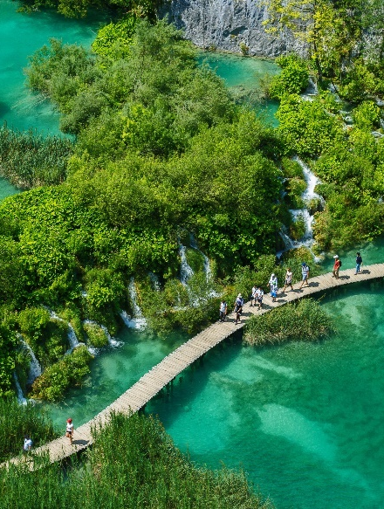
Plitvice lakes national park, croatia Examples of good practice
Interpretation efforts focus mainly on activities in Croatian. Guides for visits or recreational activities can be booked in several languages.
Recreational activities focus on experiencing a unique biosphere.
Mobile exhibition, touring Croatia
Educational programmes and workshops for primary schools

Slide 37
summary
The IUCN protected area categories system
Natura 2000
National parks in European countries
The main goal of interpretation is to provoke – Tilden‘s principles

Slide 38
references
Beck, L., & Cable, T. T. (2002). Interpretation for the 21st century: Fifteen guiding principles for interpreting nature and culture. Sagamore Pub Llc.
Carter, J. (Ed.) (2001). A Sense of Place. An Interpretive Planning Handbook, 2. https://www.jamescarter.cc/wp-content/uploads/2014/09/A_Sense_of_Place_James_Carter.pdf
European Council. (1992) Council Directive 92/43/EEC on the conservation of natural habitats and of wild fauna and flora. OJ L 206 22.7.1992, p. 7
IUCN. Increase in the number and cumulative area of nationally designated terrestrial protected areas in Europe, 1800-2020. https://www.eea.europa.eu/data-and-maps/figures/increase-in-the-number-and-1. Last modified December 2020, last accessed 17 June 2022
Tilden, F. (1957). Interpreting our heritage. University of North Carolina Press.

Slide 39
Output of the Erasmus+ K2 Strategic Partnership Project Nr. 2020-1-CZ01-KA203-078407 „Methodology of Interpretation of European Nature Heritage in Tourism" 2020 – 2023
Participating universities and their academic teams
Prague University of Economics and Business, Czech Republic;
Alexandru Ioan Cuza University of Iași, Romania;
Fachhochschule des Mittelstands, Germany;
Munster Technological University, Cork, Ireland
Universidad Europea de Madrid, Spain;
Universidade do Porto, Portugal;
University of Applied Sciences Burgenland, Austria;
Vytauto Didziojo Universitetas, Lithuania.

Slide 40
3 Water
Methodology of Interpretation of European Nature Heritage in Tourism

Slide 41
water
Water is crucial for the existence of life on our planet. It is a scarce, irreplaceable elementary material that has many meanings and uses for mankind (EVVO, 2011).
Water appears in various forms on the Earth: it is present in oceans, seas, rivers, lakes, waterfalls and rain. Water is in soil, plants and living organisms.
Water exists in three states: liquid, solid, and the gaseous state.
Nowadays we are facing extremely high consumption, which has a negative effect on water circulation in nature (WHO, 2022).
Irrational water consumption in tourism and for recreational purposes, excessive agricultural growth, and adverse climate changes will lead to a situation when water is a scarce resource.

Slide 42
bodies of water
Swaps, artificial ponds, lakes, dam lakes and other water reservoirs, seas, rivers and streams, saltwater in oceans
A lake – enclosed by land, has different origins (tectonic sags, volcanic, karst etc.
A pond – artificially created water reservoir designated primarily to breed fish, water birds and to retain water in the nature
A dam reservoir – used to retain water for purificatio of water supply, to generate elektricity, and to regulate water flows or as a protection against floods
A river – large, natural stream of flowing water. River systems are part of the planet‘s circulatory system.

Slide 43
The role of water
Oceans and seas are important for the global climate
Oceans help warm and cool various regions making them suitable for living
Evaporated water from warm seas in the form of rain or snow
Millions of species living in the water
Changes in volume and quality of water have a direct impact on the local environment and population, it is also crucial for agriculture and industry
Water is also a very important source for tourism

Slide 44
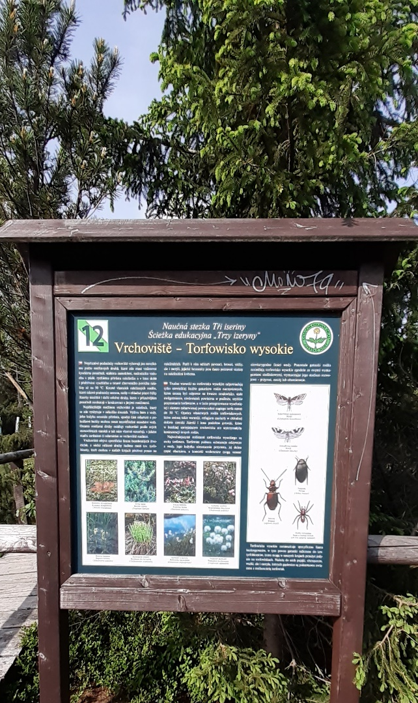
Water as a tourist attraction
Water influences the potential of a region and contributes to the cultural tourism experience, shaping cities, towns, and cultural landscapes
Recreational potential – beaches, lakes, rivers, waterfalls, wetlands
Sports tourism – diving, fishing, river rafting
Therapeutic potential – spa tourism, thalassotherapy, wellness tourism
Water elements attract nature enthusiasts – river springs, waterfalls, marshes
Technical water constructions serve as tourist attractions – aqueducts, bridges, shipping canals
Water is integrated into interior design, gardens, cultural landscapes and has inspired various art forms, including music, painting, architecture

Slide 45
Importance of water as an integral part of intangible cultural heritage
Rural tourism – spiritual values, religion and miracles. There are many traditions related to water all over the world.
Theatre performances – festivals, shows, floating stages (Lake Constance in Bregenz (A), the Minack Theatre on the cliffs in Cornwall (CB) and the Novalis celebration on the Vltava River in Prague (CZ))
Hunger stones – hydrological landmarks marking minimum water levels tied to poor harvests – common in Central Europe (Děčín (CZ), Rhine (Germany)).
Healing effects – e.g. Holy Water, God‘s Water, Good Water
Attractive transportation routes

Slide 46
Water as a scarce resource in tourism
Increased pressure on local and nature resources, including water
Increased water consumption
Increased risk of water pollution
Direct water consumption in developed countries is estimated to amount to approx. 100 litres per person per day. In developing countries, this is 10 times less.
The most water-intensive facilities and services in the tourism industry: hotel swimming pools, wellness facilities, spa services, golf resorts

Slide 47
European attractions based on water
Europe has relatively rich resources of fresh water, but unevenly distributed
Important rivers for tourism: Danube, Rhine, Rhone, Loire, Oder, Vistula, Tajo, Po, Tiber
Impressive waterfalls: Iceland (Gullfoss, Skogafoss, Dettifoss), Rhine Falls (Switzerland), Vinnufossen (Norway), Plitvice (Croatia)
Notable lakes: Finland (60,000 lakes), Pomoren Lakes, Mazur, Belarusian Lake area, Lake Balaton, Bodam, Lago Maggiore, Lake Geneva, Plitvica Lakes (UNESCO World Heritage List), but also Lochness, Königsee and Lake Hallstatt
Ponds: Třeboň (CZ)
River branches: Spreewald region (Germany) – suitable for raft cruises, UNESCO biosphere reserve

Slide 48
European attractions based on water
Glaciers: Great Aletsch Glacier (Switzerland), melting due to global warming
Geysers and thermal springs: Iceland, including the famous Geysir
Spas and mineral waters: Baden, Spa, Karlovy Vary, Vichy, Bad Ems, Baden-Baden, etc.
Dam lakes and reservoirs: Grande Dixence (Switzerland), Kaprun High Mountain Reservoir (Austria)
Fountains: Křižík‘s Singing Fountain (Prague), Di Trevi (Rome), Lions Fountain (Alhambra)
Water-themed educational centers: Hydropolis (Wroclaw), WasserWelten Krimml (Austria), Hulice House of Water (CZ)
Oceanariums and aquariums: Lisbon, Hirtshals
Water Tribunal: Valencia, Spain

Slide 49
Specifics of interpretation
The main aim is to help visitors understand the importance of the visited sights, emphasizing also the importance and value of water for our daily life
Water interpretation topics:
Tourism attractions
The importance of water in nature (in general concept)
Water consumption in tourism (Hrkal, 2018).

Slide 50
Interpretation methods
A guiding service – often offered at important nature sights, both on the land and on cruise-ships (e.g., guided cruise tour under the Rhine waterfalls)
Occasional events like open-house events on technical sights connected with water (waterpower plants, water mills, water purification plants)– visitors can visit the „backstage“ of the facility and get better insight into the operation of such facilities
Partial exhibitions on water in regional and local museums and houses of nature
Visitor centres that focus on water interpretation – the most demanding, but highly effective interpretation method (The House of Water in Hulice (CZ), the Hydropolis in Wroclaw (PL))
Printed materials – worksheets for children, a guidebook to walks along sea springs
Oceanariums and aquariums – combination of several types of intepretation, for example expositions and guides, or workshops and lectures

Slide 51
sebastian kneipp
200th birthday in 2021
German priest and healer, forefather of naturopathy
Treatment with contrasting warm water improving body temperature, blood circulation, and metabolism. Strengthens immune and nervous systems.
Kneipp‘s cure is preventive and regenerative (Wurm-Fenkl, Fischer, 2011).
UNESCO list as German Cultural Heritage

Slide 52
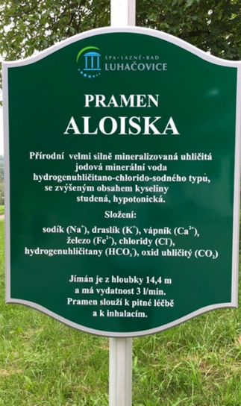
Mineral springs in Luhačovice
17 mineral springs used for balneological procedures
Springs covered with pavilions or colonnades
Information panels provide details on chemical characteristics, medical use, depth, etc.
Efficient mineral springs in Europe
Emphasizes nature richness and value
Spring Aloiska – part of signed heritage trail, spring tour named „Story of water“ (Zvuková mapa Luhačovic, 2022)

Slide 53
EXPO 2020 – Czech pavilion and czech spring
Exhibition showcasing innovative sustainable solutions
Importance of water emphasized
Photovoltaic panels and desalination mechanisms powered by solar energy
Zero net consumption of energy and water
Czech pavilion features S.A.W.E.R technology for generating water from air (CZEXPO, 2022; Veselý, 2022).

Slide 54
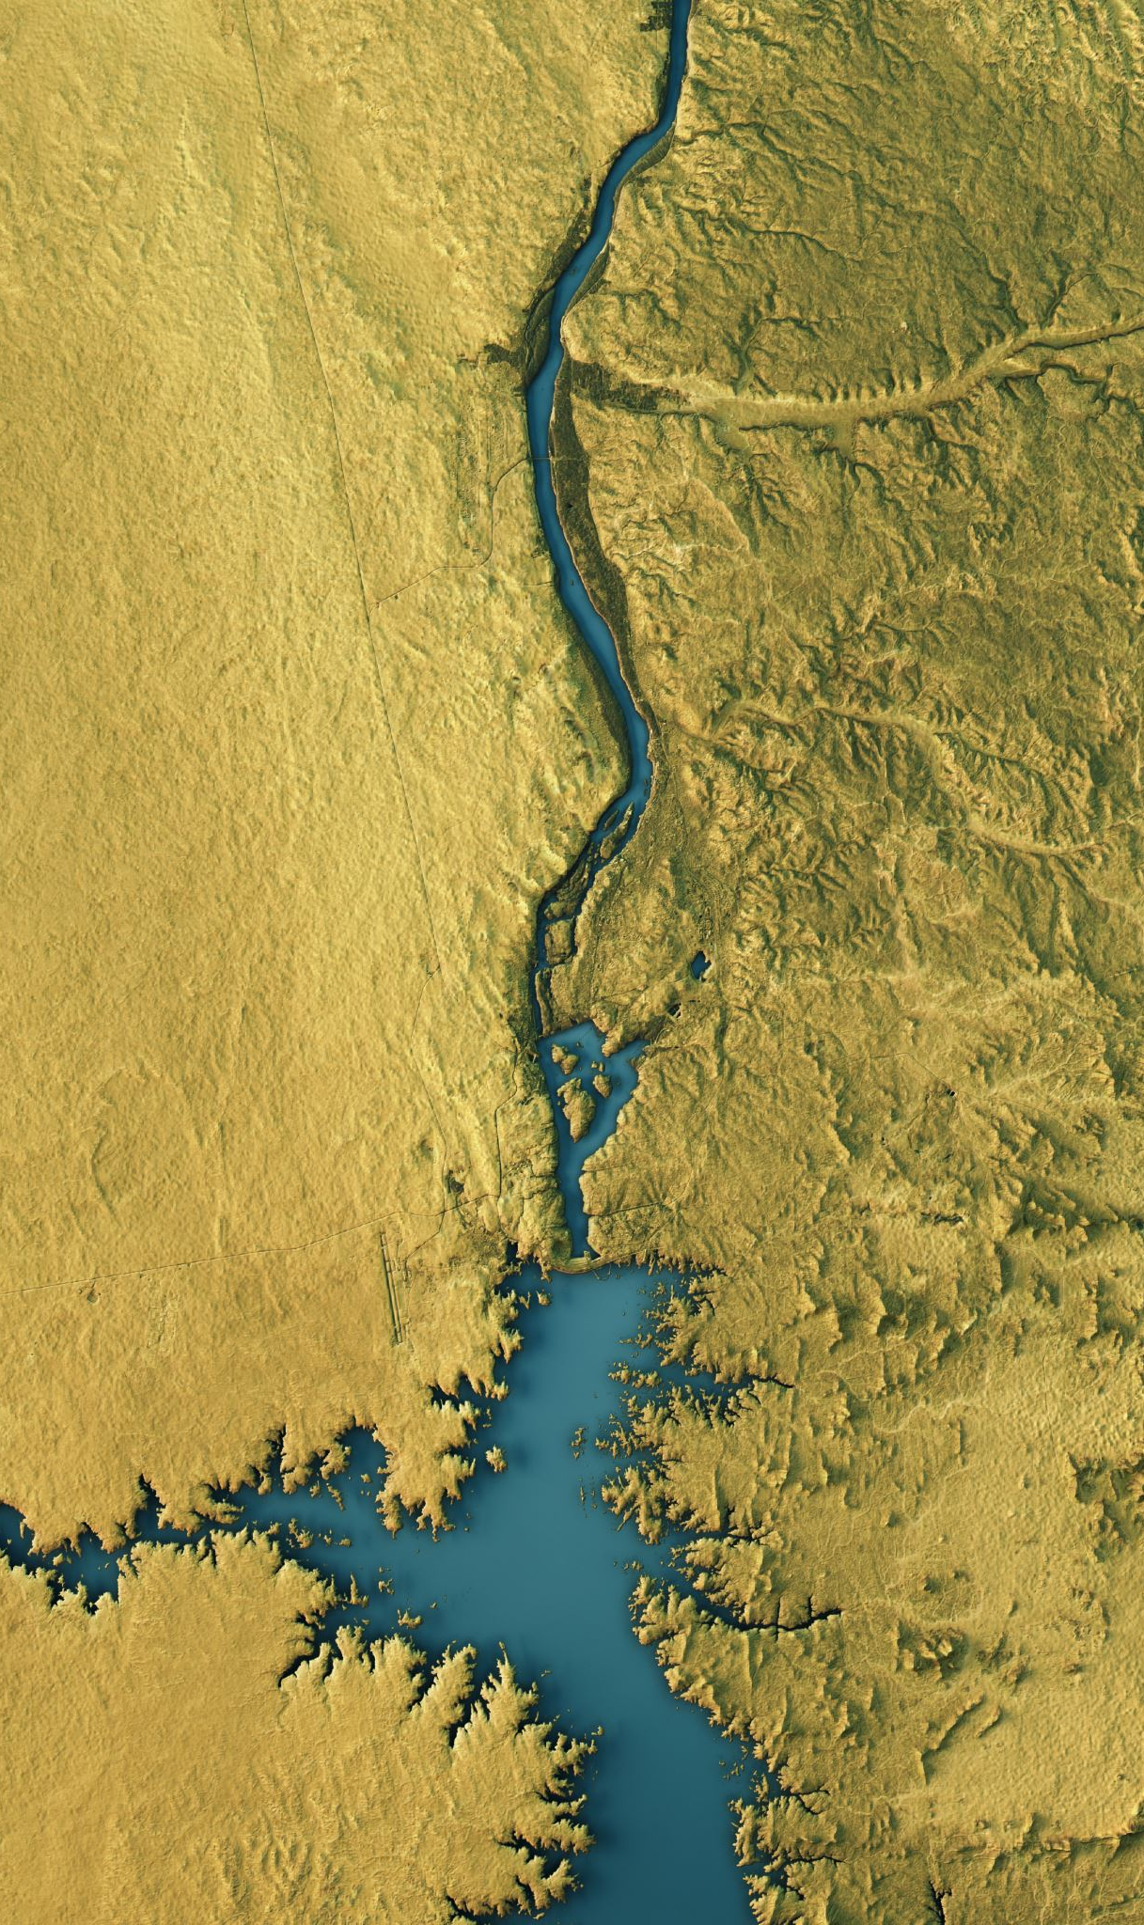
Main European watersheds model
Interactive model in the House of Water
Demonstrates flow of water from different places to seas

Slide 55
The region of live waters
Restored spewing sites of mineral waters
Built summerhouses and access boardwalks
Revitalized heritage sites
Information panels along 50-km trails
Live Waters Day celebrated on October 28th

Slide 56
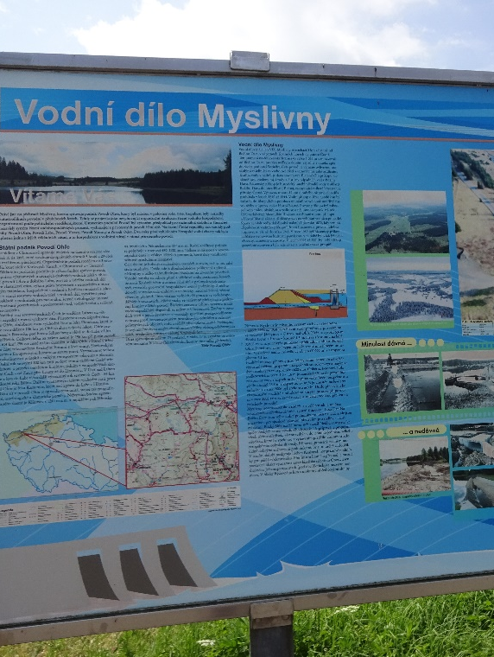
Tours and educational programmes aT waterpower stations
Complementary source of energy in the country
Guided tours for schools with history, technical data, films, models, interactive units
Waterpower station Dlouhé Stráně is a popular tourist destination
Interpretation center at the underground power statin

Slide 57
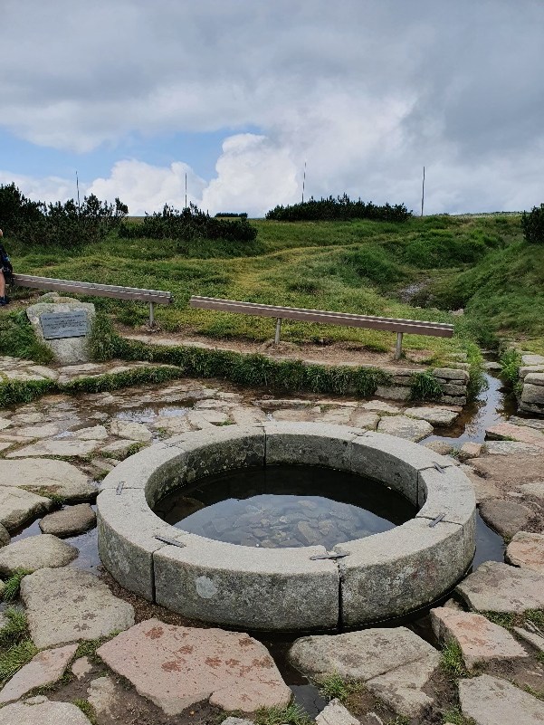
Elbe (LABE) spring
Located on Labská meadow in Krkonoše mountain ridge
Symbolic installation with coasts-of-arms and wooden statue several metres from the spring itself
Spring not accessible to the public due to nature protection

Slide 58
Tour of the underground hot spring vřídlo in karlovy vary
Hottest spring in the Czech Republic
Releases 2,000 liters of mineral water per second
Used for mineral baths and medical treatments
Underground springs showcase production of traditional souvenirs and chemical reactions

Slide 59
Summary
States and bodies of water
Water as a scarce resource
Water interpretation topics - tourism attractions, the importance of water in nature, water consumption in tourism
Interpretation methods
Examples of interpretation

Slide 60
references
Czech Republic Expo 2020. CZEXPO. 2022. Český pavilon na EXPO ocenil nejlepší inovaci, design a příspěvek k udržitelnosti. https://www.czexpo.com/aktualne/
Environmentálního vzdělávání, výchovy a osvěty Liberecký kraj. EVVO. 2011. Světový den vody - 22. březen. https://www.ekovychovalk.cz/cs/zajimavosti/mezinarodni-dny-vyznamne-pro-zivotni-prostredi/svetovy-den-vody-22-brezen.html.
Hrkal, Z.: Voda včera, dnes a zítra. Mladá Fronta 2018. ISBN 978-80-204-4989-4
WHO. 2022. Drinking-water. https://www.who.int/news-room/fact-sheets/detail/drinking-water
Wurm-Fenkl, I., Fischer, D. 2011. Kneippova léčebná metoda. Grada. ISBN: 978-80-247-3682-2
Zvuková mapa Luhačovic. 2022. Oficiální stránky města Luhačovice. https://www.zvukovamapaluhacovic.cz/

Slide 61
Output of the Erasmus+ K2 Strategic Partnership Project Nr. 2020-1-CZ01-KA203-078407 „Methodology of Interpretation of European Nature Heritage in Tourism" 2020 – 2023
Participating universities and their academic teams
Prague University of Economics and Business, Czech Republic;
Alexandru Ioan Cuza University of Iași, Romania;
Fachhochschule des Mittelstands, Germany;
Munster Technological University, Cork, Ireland
Universidad Europea de Madrid, Spain;
Universidade do Porto, Portugal;
University of Applied Sciences Burgenland, Austria;
Vytauto Didziojo Universitetas, Lithuania.

Slide 62
4 Deltas
Methodology of Interpretation of European Nature Heritage in Tourism

Slide 63
Introduction
European countries benefit from diverse natural potential
Promote tourism activities that preserve resources for long-term sustainability
Prevent degradation and ensure sustainable development for future generations
Concern for environmental protection is not new
People have always been interested in maintaining a sustainable relationship with nature
Acknowledged and practiced through specific legislation
Nature elements are valuable for tourism and agriculture – efforts to capitalize on these opportunities

Slide 64
Introduction to deltas
Require specific protection and development policies
Are formed at river mouths through shore expansion
Have underwater and subaerial parts
Waves play a crucial role in delta evolution
Human interventions negatively impact delta sustainability

Slide 65
Types of delta
The influences that contribute to landform creation
Wave-dominated
Tide-dominated
Gilbert deltas
Estuary deltas
The landform itself
Arch or fan-like deltas
Pointed (cuspate) deltas
„Bird-limb“ deltas
Reversed delta

Slide 66
deltas
Deltas have been included among the most vulnerable coastal areas
Two main sources of vulnerability (Iñaki Arto et al., 2019):
Climate factors – storms, the rise in sea levels, slumps, rainfalls, temperature variations
Socio-economic factors – economic activities, lifestyles, urbanisation, land use, demographic evolutions
Protected natural areas that also include isolated areas inaccessbile to visitors – primarily meant to preserve wildlife in its habitat
There is a link between the sustainability of a delta and the factors that support it (Vörösmarty, 2009)
Delta is an ecosytem and habitat for various species of birds and animals

Slide 67
Protected area
Protected area is clearly defined geographical space dedicated to long-term conservation of nature and cultural values
IUCN (International Union for Conservation of Nature) provides classification system for protected areas
Protection of natural areas can involve physical limitations, direct control through rules and regulations, and indirect mechanisms through education and volunteering

Slide 68
Volga delta, russia
The greatest delta in Europe
Unique hydrologic regime due to interaction between Volga river and basin without access to the Caspian Sea
Astrakhansky Biosphere Reserve manages the Delta reservoir
Eco-trails (guided tours by special ships) are preferred due to protected area management issues
Tours are conducted aboard with few short stopovers
Tours include explanations about biotopes, bird species, plants, and insects in the delta region

Slide 69
Nemunas delta, lithuania
Formed from the sand and mud brought by some rivers, the biggest of which are Nemunas and Minija
The aim to preserve the landscape, the ecosystems and the cultural heritage of the Nemunas Delta

Slide 70
Llobregat delta, spain
Benefits from beaches, pine forests, coast lagoons, agricultural lands, the Llobregat river and access to the Mediterranean Sea
Tours include marine sciences workshops, photography workshops, and educational tours for children
Can Camis pine forest is known for its variety of orchids, mushrooms, and rare bird species
Fragile forest habitat requiring a guide for visitors
Educational tour focuses on the natural beauty and characteristics of Catalonian beaches and dunes

Slide 71
Guadalquivir river delta, spain
Rare particularity: a single exit into the sea, all other exits are blocked by a huge sand bank
Unique mix of land and water has created a favourable environment for wildlife development and nature protection
Access to the park is strictly controlled in order to encourage guided tours
Many thematic visitor centres, visits by following the natural routes

Slide 72
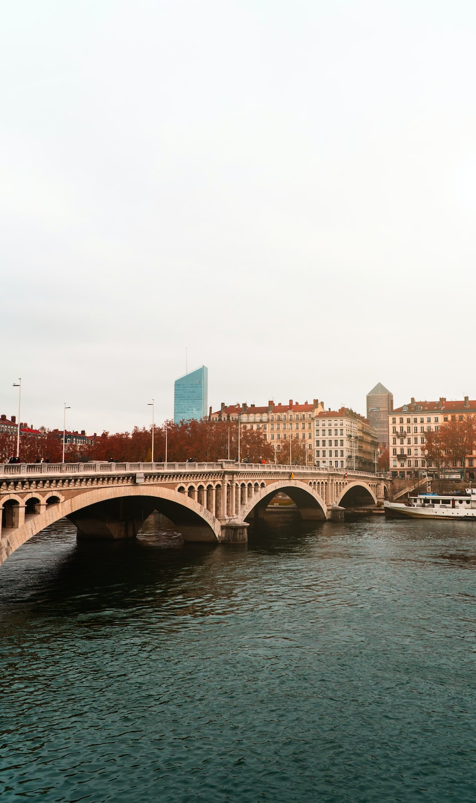
Rhône River Delta, France
Access to the sea, home to black bulls, wild white horses and flamingo birds
Multiple routes that can be accesssed by various means of transport (including by horseback)
Safaris can be accessed to explore sites, that would otherwise be difficult to access, and to view wild animals in their natural habitat
A migration area for numerous birt species
A strategic point for ornithologists
There is also a museum that introduces tourists to the flora and fauna (Camargue, France – n.d.: Girard-Gervois, 2023).

Slide 73
Delta de l’Ebre National Park, Spain
Many flora species: reed, eukalyptus, river honeysuckle and rice, which all had to adapt to extreme conditions and to colonize dunes, salty lands or lagoon areas
Wild fauna
Eco-museum introduces visitors to this exciting universe and offers a special perspective on the way the natural and human aspects of its ecosystem coexist

Slide 74
Main aspects of tourism interpretation in wild areas
Managing the interaction between fauna and tourists
Educating tourists to increase awareness and knowledge about the wild fauna
Quality interpretation contributing to tourists‘ satisfaction and commercial sustainability (Moscardo et al (2004).

Slide 75
Specifics of heritage interpretation
Large surface area guiding interpretation planning
Visitor centers with educational function
Flexibility needed for unpredictable wildlife and unpredictable weather
Managing expectations and portraying natural reality accurately
Addressing visitors‘ lack of experience
Ensuring security and safety measures

Slide 76
Main interpretation methods
Thematic or dicovery trails
Both personal and impersonal methods of interpretation
A nature trail „is a short, often loop-type trail (starting and finishing at the same point) which has been made specifically to interpret the nature of an area” (EUROPARC Consulting GmbH., 2012, p.47).
Factors influencing trail design: respect for wildlife habitats, available budgets, catering to different visitor types, specific interpretation themes, incorporating key features of the area

Slide 77
Trail infrastructure
Shelters
Benches
Litter bins
Signposts
Steps
Bridges
Viewpoints
Interpretive panels safety barriers

Slide 78
Unesco heritage
UNESCO‘s mission is to promote peace, security, education, science, and culture
Convention on the Protection of the World Cultural and Natural Heritage adopted in 1972
World Heritage List includes sites of outstanding value to humanity
UNESCO‘s strategy aligned with the 17 Sustainable Development Goals (SDGs)

Slide 79
The romanian experience
Involvement of public institutions, private organizations, and stakeholders in ecotourism development
Management plans for protected areas, including strict protection areas, full protection areas, buffer zones, and sustainable development areas
Importance of adapted and controlled offers, including visiting centers and information points

Slide 80
Danube delta biosphere reserve in romania
Biodiversity and bird-watching opportunities
Classification of habitats in the Delta – 12 habitat types (World Heritage, n.d.)
Management of international interest, of national interest, of communicty interest (Natura 2000 sites)

Slide 81
Interpretation methods of danube delta
„Delta Vie – Living Delta“ Brand
International rowboat festival „Rowmania FEST“
The Rowmania Crisan Eco-tourism Centre (CER)
Thematic trails
The "People and Birds" guidebook
The Caraorman Bird Sanctuary

Slide 82
summary
Partnerships are key to success in eco-tourism development
Trail infrastructure
Innovating approaches (such as Living Delta Brand, Rowmania Festival, etc.) are crucial for unique interpretation methods

Slide 83
references
Arto, I., Garcia-Muros, X., Cazcarro, I., González-Eguino, M., Markandya, A., & Hazra, S. (2019). The socioeconomic future of deltas in a changing environment. Science of the Total Environment, 648, 1284–1296. https://doi.org/10.1016/j.scitotenv.2018.08.139.
Camargue, France: travel, tourism and attractions in Camargue Natural Park. (n.d.). https://www.francethisway.com/places/camargue.php
EUROPARC Consulting GmbH [ECEAT – Projects and Lauku Ceļotājs] & the Latvian Country Tourism Association. (2012). A starter guide to developing sustainable tourism in protected areas. retrieved from https://portals.iucn.org/library/sites/library/files/documents/SPE-Tou-064.pdf
Girard-Gervois, J. (2023, February 20). Camargue: Must See Area of Southern France That Will Surprise You. Trip USA France. https://tripusafrance.com/camargue-must-see-area-of-southern-france/

Slide 84
references
Moscardo, Gianna, Barbara Woods and Rebecca L. Saltzer, (2004). The role of interpretation in wildlife tourism, retrieved from https://researchonline.jcu.edu.au/7500/1/7500_Moscardo_et_al_2004.pdf
Vörösmarty, C. J., Syvitski, J., Day, J., de Sherbinin, A., Giosan, L., & Paola, C. (2009). Battling to Save the World’s River Deltas. Bulletin of the Atomic Scientists, 65(2), 31–43. https://doi.org/10.2968/065002005
World Heritage. (n.d.). Danube Delta. World Heritage Data Sheet. Retrieved March 4, 2023, from http://world-heritage-datasheets.unep-wcmc.org/datasheet/output/site/danube-delta/ /site/danube-delta/

Slide 85
Output of the Erasmus+ K2 Strategic Partnership Project Nr. 2020-1-CZ01-KA203-078407 „Methodology of Interpretation of European Nature Heritage in Tourism" 2020 – 2023
Participating universities and their academic teams
Prague University of Economics and Business, Czech Republic;
Alexandru Ioan Cuza University of Iași, Romania;
Fachhochschule des Mittelstands, Germany;
Munster Technological University, Cork, Ireland
Universidad Europea de Madrid, Spain;
Universidade do Porto, Portugal;
University of Applied Sciences Burgenland, Austria;
Vytauto Didziojo Universitetas, Lithuania.

Slide 86
5 VOLCANOES / Azores
Methodology of Interpretation of European Nature Heritage in Tourism

Slide 87
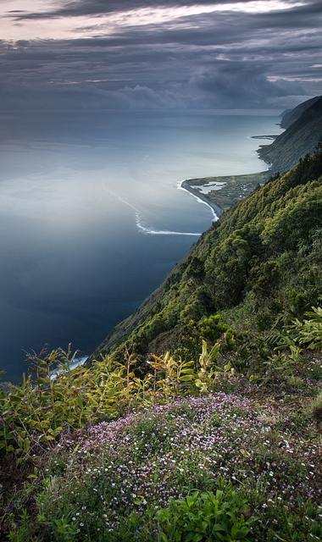
Introduction to the azores
Archipelago of nine islands in the North Atlantic Ocean
Unique geological features due to its position on three tectonic plates
Not yet discovered by mass tourism
Certified as a sustainable destination (EarthCheck)
Environmentally integrated interpretative centers

Slide 88
Geotourism and the ABC model
Most problems result from a lack of connection between mankind and nature (Pásková et al, 2021).
Geotourism focuses on geology, landscape, and the interconnections between abiotic, biotic, and cultural elements
ABC model: Abiotic (climate and soil), Biotic (animals and plants), Cultural (human) elements (Dowling, 2013).
Geotourism facilities like geo-trails, guided tours, and interpretation centers educate visitors and create a connection with the landscape

Slide 89
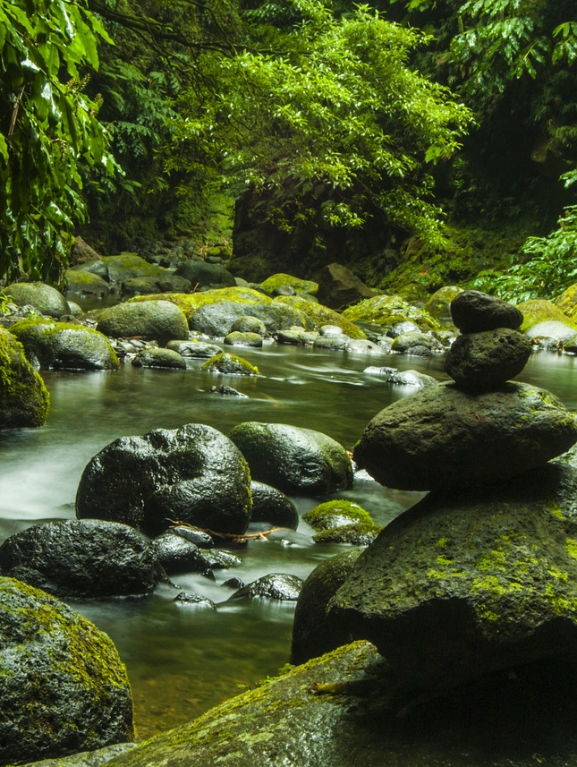
Geotourist types
Geo-experts or geo-specialists with a strong interest in geology (Dowling et al., 2021, p. 119)
Incidental, accidental, serendipitous, intentional, and purposeful geotourists (Dowling et al., 2021, p. 119),
Interpretation and didactic activities are important to cater to different types of geotourists and minimize cultural intrusion and disruption.

Slide 90
Objectives of heritage interpretation
Heritage interpretation is a communication process that links visitors with the abiotic, biotic and cultural environment.
Goes beyond education, includes recreation, conservation, and awareness (Zeppel & Muloin, 2008).
Aims to provoke reflection and change, contributing to sustainable behavior (Borges de Lima, 2017, p. 127).

Slide 91
Impact of heritage interpretation
Advantages: visitor management, local economic benefits, local environment development, community involvement, values, and attitudes
Pitfalls: economic imperatives, selection and simplification, overinterpretation, elitism, creating 'quaint' tourist landscapes, politics, beliefs and integrity (Bramwell and Lane, 2005).
Interpretation plays a role in balancing conservation and economic imperatives, educating visitors, and promoting responsible behavior

Slide 92
Visitor management
Developing and implementing rules and regulations for visitor activity
Pre-defined routes and protection of fragile areas
Increased visitor numbers in lesser-known regions and control of fashionable areas

Slide 93
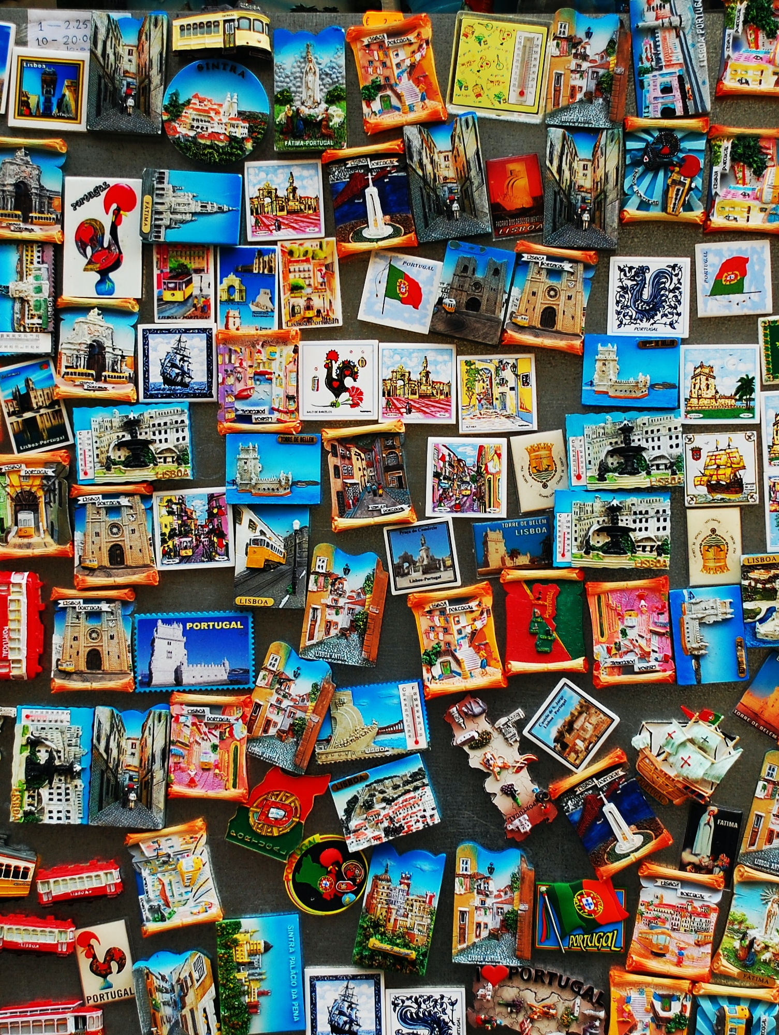
Local economic benefits
Interpretation enhances economic effects through visitor spending on attractions, souvenirs, and local consumption
Direct and indirect job creation

Slide 94
Local environment development
Interpretation helps visitors understand the habitat and its species, leading to greater respect and less intrusive behavior (Herbert, 1989).
Professional guides prevent inconsiderate behavior and disturbance to wildlife (Newsome, 2005, p. 185).

Slide 95
Community involvement
Involving the local community in interpretation enhances its authenticity and effectiveness
Raises community's sense of place, empowers individuals, and strengthens group identities (Machin, 1989).

Slide 96
Values and attitudes
Efficient interpretation fosters a harmonious relationship between abiotic, biotic, and cultural elements.
Leads to appreciation, protection, and conservation of the visited site and culture.
Encourages responsible and caring attitudes and behaviors towards the place and heritage (Bramwell & Lane, 2005).

Slide 97
Economic imperatives
Economic objectives overshadow community well-being and environmental concerns (Bramwell & Lane, 2005, p. 23).
Overestimation of economic viability disregards environmental impacts.
Loss of original meaning through selective focus.

Slide 98
Selection and Simplification
Complex considerations require selection and simplification.
Distortions and loss of meaning may occur.
Limited time, prior knowledge, and diverse groups influence the process.

Slide 99
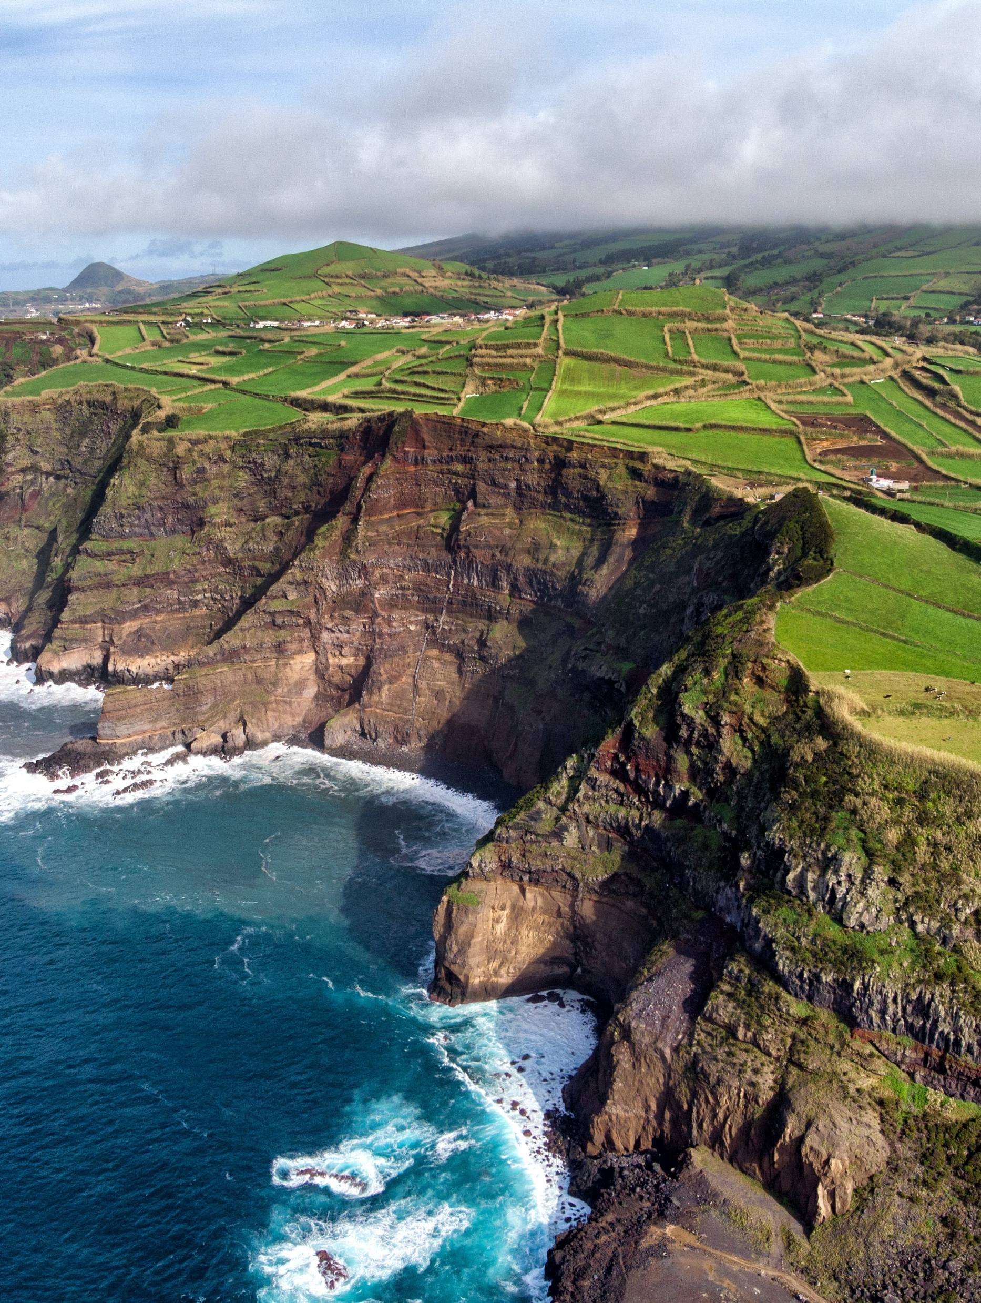
Danger of Overinterpretation
Unnecessary interpretation diminishes enchantment (Bramwell and Lane, 2005).
Theoretical discussions demotivate visitors – involving visitors enhances engagement (Newsome, 2005, p 206).

Slide 100
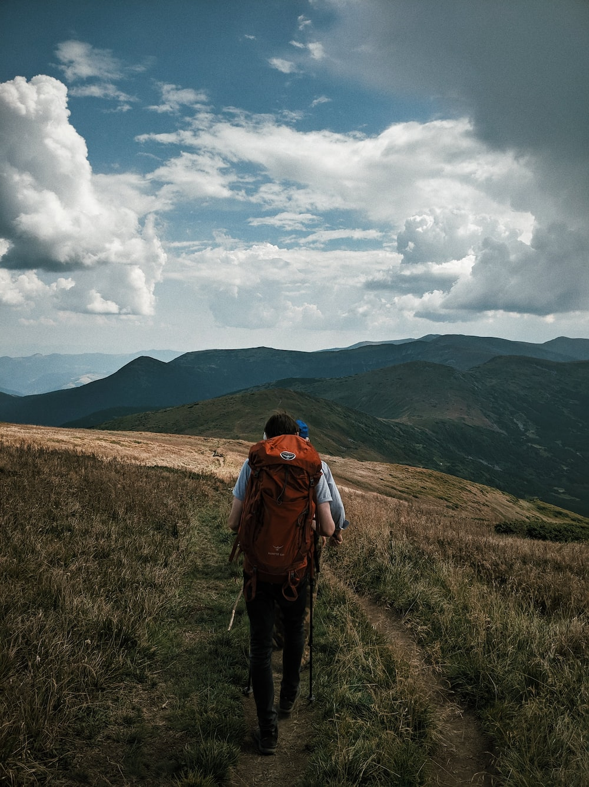
Danger of elitism
Guides opposing mass tourism exclude non-enthusiasts
Heritage interpretation aims to train behavior and attitudes
Addressing only like-minded individuals limits interpretation

Slide 101
Danger of intrusion
Tourism massification raises concerns about intrusiveness.
Protection of local inhabitants and culture is necessary (cf., Gartner, 1996).
Interpretation plays a crucial role in protecting locals from damages and prejudice, adapting and absorbing the advantages of tourism while, at the same time, protecting places from turning into thematic parks.

Slide 102
Danger of creating „quaint“ tourist landscapes
Visitors‘ prefer the „unknown“ (Urry, 1990) – the danger of exacerbating the aspects that are different, creating “quaint” tourist landscapes.
Entertainment-focused interpretations hinder local expression.
Sterilized aesthetics undermine the essence of the landscape (Bramwell & Lane, 2005, p. 25).

Slide 103
Politics, beliefs and integrity
History and sense of place are political (Bramwell and Lane, 2005, p. 25).
There is the tendency to downplay and/or mask the problems, it is difficult to overcome the resulting clichés (Bramwell and Lane, 2005).

Slide 104
Interpretation techniques

Slide 105
Factors affecting learning outcomes with a professional guide
Visitors' educational level
Communication with previous visitors
Visitors' preparation on topics
Guide's competence
Guide's communication skills and personality
Visitor interaction with the guide
Motivation levels of guide and visitor
On-site interpretation aids

Slide 106
Wildlife Interpretation
Considering target audience
Active involvement and relevance
Make the experience enjoyable
Generate curiosity and interest
Use personal contact

Slide 107
Direct guided experiences
The most efficient form of interpretation
Three stages:
Guides provide good practice guidelines and mitigate inappropriate behavior.
creating a perceived need for information,
providing required information in an informal and interesting manner,
participation in follow-up activities
(Forestell and Kaufman, 1990; Lück, 2008)

Slide 108
Inspiring guide characteristics
Guides translate technical language into understandable terms
They entertain and engage non-scientist tourists (Ham, 1992 in Borges de Lima, 2017, p. 122).
Excellent leadership skills are essential
Trustful experts who promote respect for culture and local specificities

Slide 109
Spheres of tour guiding
Group management: Organizing and managing the group
Experience management: Facilitating individual engagement and learning
Resource/site management: Focusing on sustainability of environments, communities, and destinations (Borges de Lima, 2017, p. 124).

Slide 110
Unforgettable Experiences
Intense engagement, loss of sense of time, and self-transcendence (Ham, 2004).
Direct emotional connection with the phenomenon
Some visitors prefer contemplation and observation of nature (Borges de Lima, 2017, p. 172).

Slide 111
São Miguel Island
The largest island of the Azores in terms of area and population
Rich in lakes formed in the calderas of ancient volcanoes, has unique beauty
The most famous lake is Lagoa das Sete Cidades – the largest freshwater reservoir in the Azores. Is composed of two lagoons, one with blue waters and one with green waters.
Cyclo-guide are a regular presence in tourism on the island.
The Microbial Observatory of the Azores (OMIC) – allows visitors to observe native microorganisms under the microscope.
The Azores Volcanological and Geothermal Observatory (OVGA) – detailed explanations about the formation of the archipelago.

Slide 112
Faial island
The Capelinhos volcano eruption in 1957 caused the island of Faial to grow by 2.4 km2.
The eruption formed an autonomous island in front of Faial, which eventually joined the existing island.
Due to erosion, only 1/3 of the new territory created by the eruption remains.
The Capelinhos Volcano Interpretation Centre provides an interpretative journey explaining the phenomenon in geological terms.
The centre is integrated into the landscape and uses modern sound and image technologies for accessible interpretation.
The tour guides at the centre are well-educated locals, providing emotional and insights into the eruption's social consequences.

Slide 113
Pico island
Home to Portugal's highest mountain, Pico volcano.
Challenging ascent monitored by Casa da Montanha for safety.
Unique Pico Island Culture Landscape with vineyards on basalt walls.
Gruta das Torres: One of the world's largest volcanic tubes.
Interpretative center provides volcanology insights and safety instructions.
Guided tours with limited numbers in the tube.

Slide 114
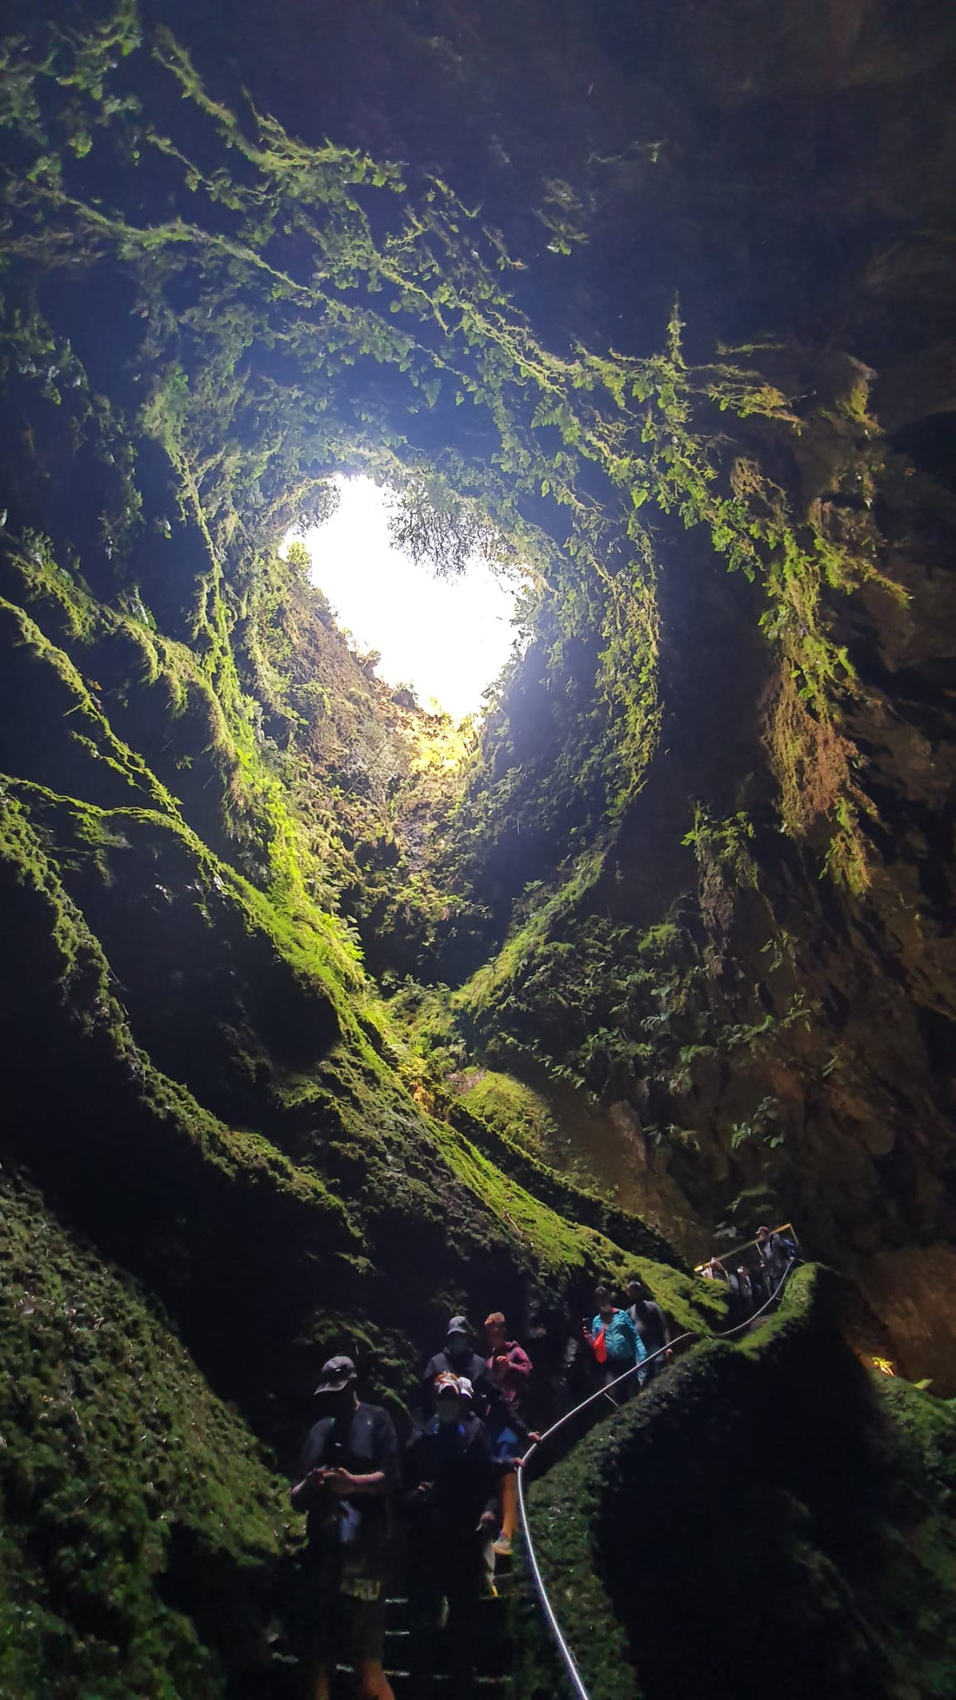
Terceira island
Third largest island in the Azores, renowed tourist destination.
Capital, Angra do Heroísmo, designated as UNESCO World Heritage site.
Unique attraction: Algar do Carvão, a volcanic chimney with 100m drop.
Visitors can explore at their own pace with assistance from on-site guides.
Harmoniously integrated interpretative center provides information and ensures safety.

Slide 115
The ocean
Unique maritime landscape.
Offers various marine activities: whale and dolphin watching, diving, fishing, surfing, etc.
March to November is whale and dolphin watching season.
Respect for animal life cycle emphasized during observation.
Diving provides opportunities to explore underwater volcanic formations and diverse marine life.

Slide 116
summary
Geotourism relies on the appeal of the destinations to potential visitors.
Balancing the abiotic, biotic, and cultural elements is crucial in making these places more appealing.
Differentiating the types of geotourists
Heritage interpretation strategies encourage tourists to preserve natural attractions and behave appropriately.
The Azores Case Study

Slide 117
references
Borges de Lima, I. (2017). Wildlife Resources, Habitats and Ecosystems for Visitors’ Experiential Learning: Educative Wildlife Tourism in the Australian Context. In Wildlife Tourism, Environmental Learning and Ethical Encounters (pp. 113-154). Springer, Cham.
Bramwell, B., & Lane, B. (2005). Interpretation and sustainable tourism: The potential and the pitfalls. Revista Interamericana de Ambiente y Turismo, 1(1), 20-27.
Dowling, R. (2013). Global geotourism – an emerging form of sustainable tourism. Czech Journal of Tourism, 2(2), 59-79.
Gartner, W. C. (1996). Tourism Development: Principles, Process and Policies. Van Nostrand Reinhold, ITP, International Thompson Publishing, London.
Ham S, Weiler B (2004). Introduction to interpretation. Paper presented to a workshop on interpretation at tertiary level: beyond visitor satisfaction. QUT, Brisbane. Day?

Slide 118
references
Herbert, D.T. (1989). Does interpretation help? In D.T. Herbert, R.C. Prentice and C.J Thomas (eds) Heritage Sites: Strategies for Marketing and Development (pp. 191-230). Aldershot: Gower.
Machin, A. (1989). The social helix: Visitor interpretation as a tool for social development. Heritage Interpretation, 2, 149-155.
Newsome, D., Dowling, R. K., & Moore, S. A. (2005). Wildlife tourism. In Wildlife Tourism. Channel View Publications.
Pásková, M., Zelenka, J., Ogasawara, T., Zavala, B., & Astete, I. (2021). The ABC Concept. Value added to the Earth heritage interpretation? Geoheritage, 13(2), 1-25.
Urry, J. (1990). The Tourist Gaze. London: Sage.
Zeppel, H., & Muloin, S. (2008). Marine wildlife tours: Benefits for participants. Marine wildlife and tourism management: Insights from the natural and social sciences, 19-48.

Slide 119
Output of the Erasmus+ K2 Strategic Partnership Project Nr. 2020-1-CZ01-KA203-078407 „Methodology of Interpretation of European Nature Heritage in Tourism" 2020 – 2023
Participating universities and their academic teams
Prague University of Economics and Business, Czech Republic;
Alexandru Ioan Cuza University of Iași, Romania;
Fachhochschule des Mittelstands, Germany;
Munster Technological University, Cork, Ireland
Universidad Europea de Madrid, Spain;
Universidade do Porto, Portugal;
University of Applied Sciences Burgenland, Austria;
Vytauto Didziojo Universitetas, Lithuania.

Slide 120
6 nature parks and reserves
Methodology of Interpretation of European Nature Heritage in Tourism

Slide 121
definitions
Regional Nature Parks – government recognised or government-designated protected areas with the objective of protecting nature and landscapes (Living Landscapes, 2017, p. 8).
Regional park – a territory where the landscape and cultural values characteristic of that region are protected.
Observation tower – a structure commanding a wide view of its surroundings.
The total economic value (TEV) – consists of the values of the direct, indirect and option use, which together constitute the use value, and the bequest and existence values, which constitute the non-use value of nature heritage goods.

Slide 122
Development of regional nature parks IN EUROPE
Regional nature parks in Europe have diverse development strategies and structures.
German Nature Parks (late 1950s) – established to provide recreational opportunities and protect specific natural areas.
French Regional Nature Parks (1967) – to protect inhabited territories with remarkable natural and cultural heritage.
Italy – focusing on local authorities' park development.
Spain – having various legal forms for protected areas.
Eastern European countries have predominantly state-managed protected areas, with a gradual shift towards decentralization and participation.
Nordic countries (such as Norway and Iceland) – have embraced the concept of regional parks, with a focus on enhancing natural and cultural values.
Danish regional parks – similar to the German model, while Norwegian and Icelandic parks are based on the French model.

Slide 123
Regional parks today
Around 900 Nature Regional Parks in 22 European countries
Regional Parks promote biodiversity protection, sustainable land use, and local socio-economic development.
Aim to protect landscape, culture, and natural heritage while integrating sustainable development and climate protection.
Regional Nature Parks connect the European Union to its citizens and support the goals and strategies of the European Union.

Slide 124
Protected areas of lithuania
Incorporate the protection of living and inanimate elements, including natural and cultural heritage.
The system of protected areas in Lithuania follows a complex approach that involves cooperation between specialists from various areas.
The system of protected areas is divided into 5 groups of territories: national parks, historic national parks, regional parks, nature reserves, and natural monuments.

Slide 125
Regional parks of lithuania
Lithuania has 30 regional parks, categorized based on landscape type (Protected areas of Lithuania, 2019, p. 146).
Include coastal and lagoon parks, river valley parks, lake parks, valleys and lakes rich hilly areas parks, valley parks, plateau and plain parks, and complex typologically diverse complexes parks.
Protect unique landscapes, ecosystems, natural and cultural treasures, and regional recreational resources.
Some parts of regional parks in Lithuania are important for their endangered habitats and species and are included in the Natura 2000 network.
Opportunities for ecotourism, aim to protect natural and cultural heritage.
Each regional park in Lithuania is adapted for public access and has visitor infrastructure, educational trails, forest parks, and sightseeing spots (Living Landscapes, 2017, p. 112).

Slide 126
Anykščiai Regional Park
Treetop Walking Path offers a unique opportunity for eco-friendly tourism.
Honored with the highest prize in the UNWTO Awards for Innovation in Enterprises in 2016.

Slide 127
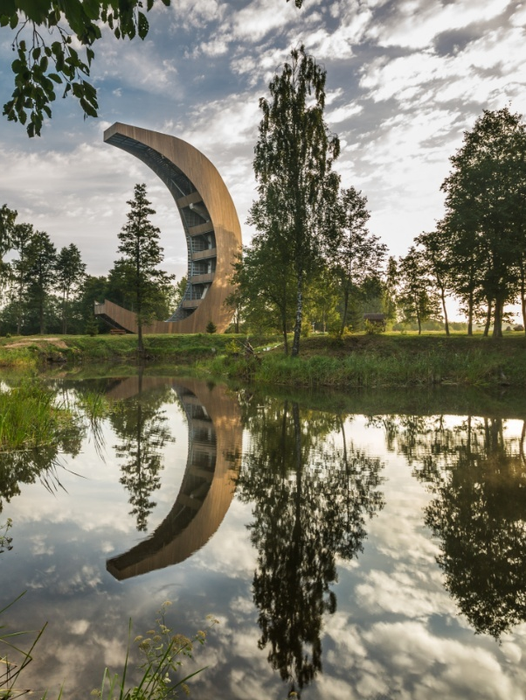
birzai Regional Park
Mysterious sinkholes formed by groundwater washing away gypsum layers.
Kirkilai Observation Tower provides panoramic views of the Kirkilai Karst Lakes.

Slide 128
Krekenava Regional Park
Visitors' Centre with a playful exposition showcasing the regional park's uniqueness.
30m observation tower offers a wonderful view of Nevėžis Valley and old riverbeds.

Slide 129
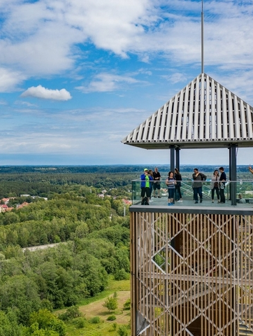
Nemunas Loops Regional Park
Birstonas Observation Tower, 51m high, provides a commanding view of the town.
Tower's unique structure evokes a defensive castle or a church belfry.

Slide 130
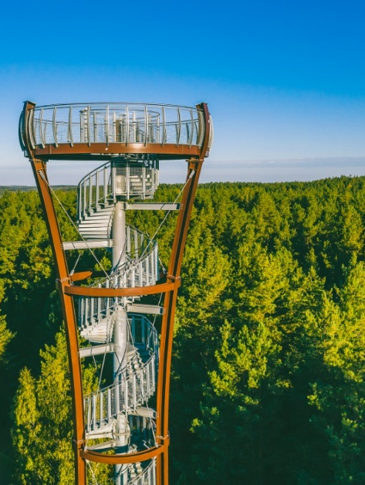
Labanoras Regional Park
Second tallest observation tower in Lithuania, 36m high.
Astounding bird's-eye view of forests and the Baltieji Lakajai and Juodieji Lakajai lakes.

Slide 131
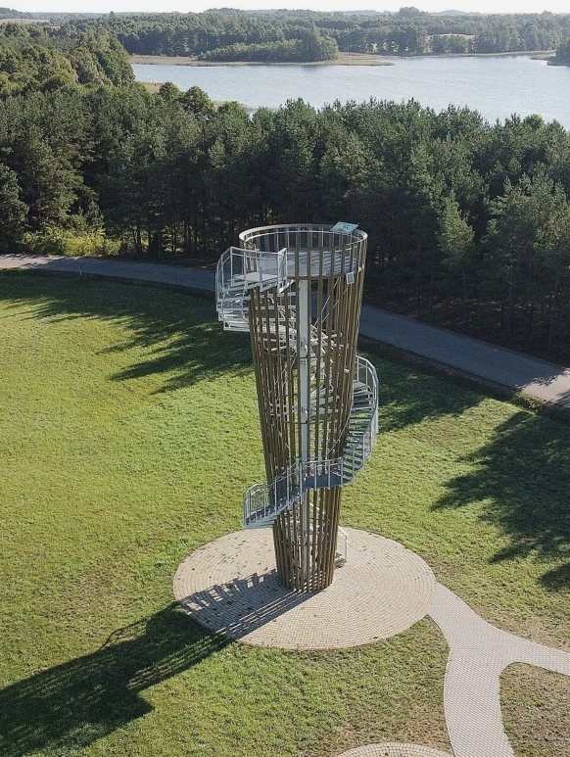
Veisiejai Regional Park
Veisiejai observation tower, 15m high, offers panoramic views of Lake Snaigynas and the town of Veisiejai.
Lake Snaigynas is a great spot for fishing, home to various fish species.

Slide 132
Value of nature objects/heritage

Slide 133
Values of lithuanian regional park
Direct use values: non-consumptive use values like recreation and enjoying infrastructure. COVID-19 increased visits to national/regional parks, leading to overtourism in Nerijos regional park.
Indirect use values: ecosystem services (water, soil, pollination, biological control, water purification, etc.) There is still a lack of understanding of these values by people.
Different groups of visitors: biologists/ecologists, adults with kids, and students

Slide 134
Summary
Regional nature parks in Europe have diverse development strategies and structures.
There is around 900 Nature Regional Parks in 22 European countries. They aim to protect landscape, culture, and natural heritage while integrating sustainable development and climate protection.
The system of protected areas is divided into 5 groups of territories: national parks, historic national parks, regional parks, nature reserves, and natural monuments.
Total economic value consists of the values of the direct, indirect and option use.

Slide 135
references
Living Landscapes. 2017. Europe`s Nature, Regional, and Landscape Parks – model regions for the sustainable development of rural areas, Verband Deutscher Naturparke.
Nature Regional Landscape Parks. 2020). EUROPARK Federation.
Protected areas of Lithuania 2019. State Protected Areas Service.

Slide 136
Output of the Erasmus+ K2 Strategic Partnership Project Nr. 2020-1-CZ01-KA203-078407 „Methodology of Interpretation of European Nature Heritage in Tourism" 2020 – 2023
Participating universities and their academic teams
Prague University of Economics and Business, Czech Republic;
Alexandru Ioan Cuza University of Iași, Romania;
Fachhochschule des Mittelstands, Germany;
Munster Technological University, Cork, Ireland
Universidad Europea de Madrid, Spain;
Universidade do Porto, Portugal;
University of Applied Sciences Burgenland, Austria;
Vytauto Didziojo Universitetas, Lithuania.

Slide 137
7 cultural landscape, palace gardens, zoos, botanical garden
Methodology of Interpretation of European Nature Heritage in Tourism

Slide 138
Cultural landsapes
Cultural landscapes are at the interface between nature and culture, tangible and intangible heritage, biological and cultural diversity – they represent a closely woven net of relationships, the essence of culture and people’s identity.
Cultural landscapes are a focus of protected areas in a larger ecosystem context, and they are a symbol of the growing recognition of the fundamental links between local communities and their heritage, humankind and its natural environment (Rössler, 2006, p. 334).

Slide 139
Categories of cultural landscape
Clearly defined landscape – designed and created intentionally by man
Organically evolved landscape – results from an initial social, economic, administrative, and/or religous imperative. They fall into two sub-categories:
A relict (fossil) landscape
A continuing landscape
Associative cultural landscape – justifiable by virtue of the powerful religious, artistic, or cultural associations of the natural element rather than material cultural evidence

Slide 140
Palace gardens
There is no universally valid definition of a palace garden.
A castle garden is here defined as a garden that belongs to a castle.
Gardens have outstanding natural, cultural and historical features with a unique history that has the potential to provide the visitor with an authentic experience.

Slide 141
zoos
Zoos are “permanent facilities in which live animals of species that live in the wild are kept, for purposes of display, for a period of at least seven days of the year” (Bundesnaturschutzgesetz, BNatSchG, 2009).
The defining feature of a zoo is the display of animals of wild species.
Zoos evolved into places of recreation and leisure
Zoos now play an active role in wildlife conservation and provide learning experiences for tourists
Emotional connection with animals in zoos improves attitudes towards conservation
Understanding visitor characteristics and exhibit design is key to shaping visitor experience

Slide 142
Botanical gardens
Botanical gardens are “institutions holding documented collections of living plants for the purpose of scientific research, conservation, display and education” (Botanic Gardens Conservation International (BGCI), 2021).
Botanical gardens serve as nature-based recreational contexts and explore visitors' perceptions of changing local climates.
Visitor awareness and concern can influence recreation management in natural areas
Botanical gardens provide a framework for educational programs to raise awareness of sustainability issues
Botanical gardens have great potential for educating tourists, visitors, and local people.

Slide 143
Specifics of heritage interpretation
Aspects:
Knowledge transfer regarding nature and cultural landscapes
Evoking of emotions for nature and cultural landscapes (Swedish Centre for Nature Interpretation, SCNI, 2017).
The main aims of heritage interpretation:
Learning experience
Positive emotional experience in nature
Stimulation of participants’ own reflections i.e. regarding sustainability
Affecting of participants’ attitudes and/or behaviour patterns

Slide 144
Core-domain-sphere model by donald meinig
The following aspects need to be considered:
Infrastructure (layout, type/purpose, architecture)
Names (of neighbourhoods, buildings, streets, sports teams)
Natural features (presence, removal or placement of trees; water systems; role of natural elements in shaping the built environment; adaptation of human systems and infrastructure to the environment)
Local customs
Other material and immaterial culture
Sphere
Domain
Core
(Rosenfeld and Burtch, 2021)

Slide 145
Material vs. nonmaterial culture
Material culture – various material objects produced and used by a culture
Immaterial culture – intangible ideas of cultures that are not directly linked to material objects (Rosenfeld & Burtch, 2021).
Typical questions:
How has history, time and scale affected this landscape?
What do fences tell us about the culture?
How is the local infrastructure adapted to agricultural practices? What do the language and naming practices in this landscape tell us about local history and tradition?
What is the relationship between people and livestock and how is this reflected or revealed in the landscape?”

Slide 146
Dessau-Wörlitz Garden Realm, Germany
Designated as a UNESCO World Heritage Site in 2000
Exceptional example of landscape design from the 18th century (Kultur Stiftung Dessau Wörlitz, 2021).
Features English-style parks and gardens with ancient-style temples
Offers guided tours, gondola rides, Wörlitz lake concerts, and guided cycling tours

Slide 147
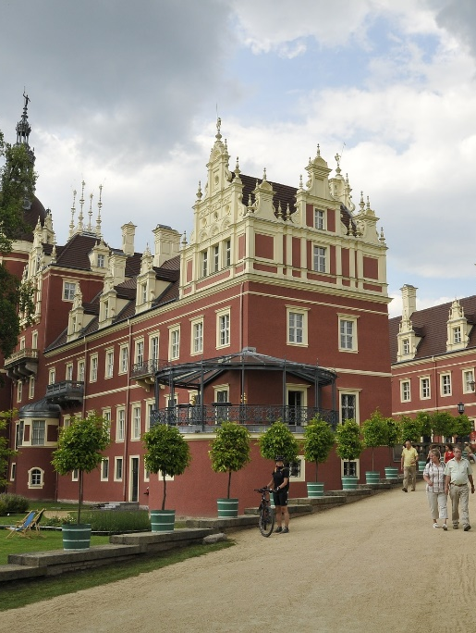
Muskau Park, Germany/Poland
Listed as a joint Polish-German heritage site by UNESCO
Laid out by Prince Hermann von Pückler-Muskau in the 19th century
Covers an area of approximately 700 ha
Offers exhibitions, visiting the castle nursery, guided tours, children's birthday parties, Muskau forest railway, and carriage rides

Slide 148
Palace and gardens of Schönbrunn
Listed as a UNESCO World Heritage Site in 1996
Former residence of Habsburg emperors with Baroque gardens
Offers a virtual tour of the park, maze, labyrinth, and guided tours

Slide 149
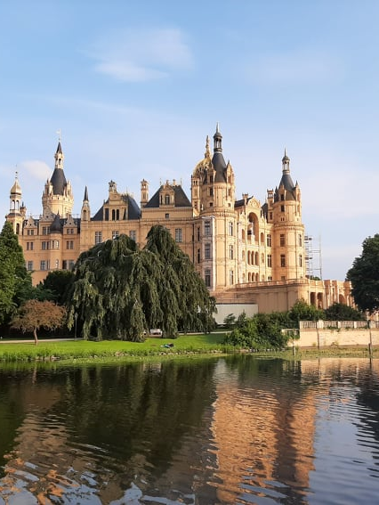
Schwerin Palace GardeN
Originally a pleasure garden transformed in the 18th and 19th centuries
Preserves the basic baroque structure with landscaped surroundings
Covers an area of about 25 ha
Offers guided tours and gourmet garden experiences (Welterbe Schwerin Förderverein, 2021).

Slide 150
Zoo academy Heidelberg
Educational department of Heidelberg Zoo
Covers animals & nature, exhibition, technology, and laboratory categories
Offers workshops, school class/kindergarten programs, scientific experimentation, modern technology, interactive exhibitions, and visiting zoo animals with special observation offers (Zoo Heidelberg, 2021).

Slide 151
The botanical garden of Padua
UNESCO World Heritage Site since 1997
The first botanical garden in the world with a circular layout
Offers educational workshops and guided tours covering various topics in botany, cultivation, biodiversity, and ecology

Slide 152
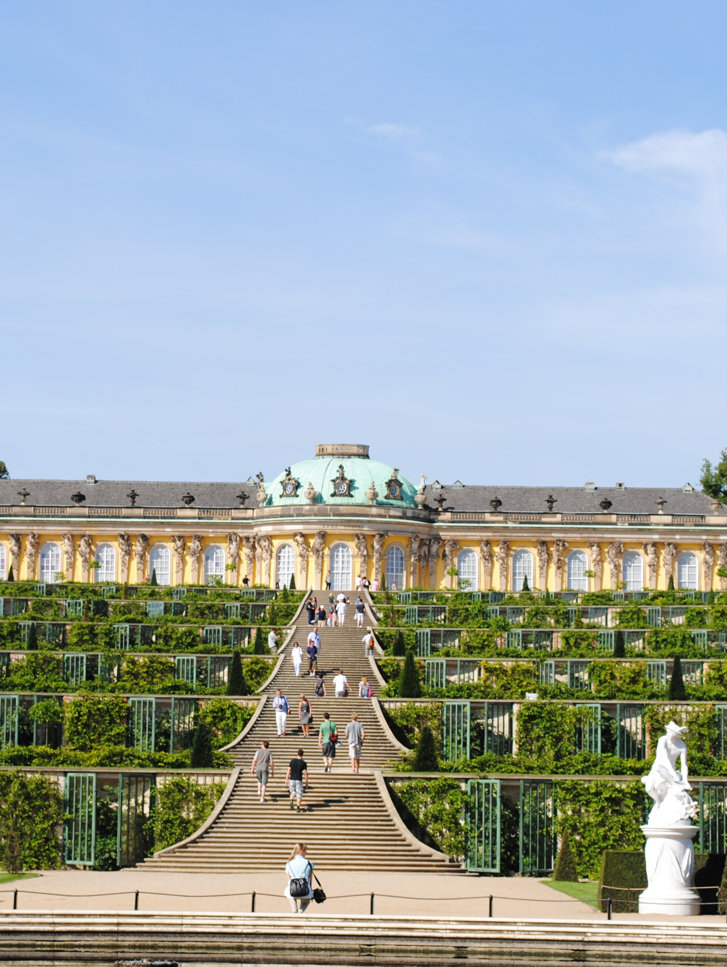
The palaces and parks of potsdam and berlin
UNESCO World Heritage Sites since 1990
Fulfillment of UNESCO criteria
Area of approximately 500 ha with 150 buildings

Slide 153
The palaces and parks of potsdam and berlin: target groups
Family & children – special events, workshops, guided tours, fairytale festivals, children‘s birthday parties
Preschool & school – programs on cultural and art history for school classes, playful approach
Visitors with special needs – recommended route for mobility and visually impaired visitors, barrier-free accress as a goal
Digital offers – virtual tour and digital exhibitions, YouTube clips and behind-the-scenes glimpses, online exploration of specific sites
(Stiftung Preussische Schlösser und Gärten Berlin-Brandenburg, 2021) .

Slide 154
summary
Cultural landscapes is divided into three categories:
clearly defined landscape,
organically evolved landscape,
associative cultural landscape
Palace gardens, botanical gardens, zoos
Two models:
Core-domain-sphere
Material vs. nonmaterial culture

Slide 155
references
Berlin, Potsdam and Brandenburg. Retrieved from https://www.spsg.de/en/palaces-gardens/palaces-and-gardens-overview/
Botanic Gardens Conservation International (2021). What is a Botanic Garden? Retrieved from https://www.bgci.org/about/botanic-gardens-and-plant-conservation/ https://www.gartenreich.de/de/schloesser-u-gaerten/woerlitz https://www.slu.se/en/Collaborative-Centres-and-Projects/swedish-centre-for-nature- interpretation/nature-interpretation-in-sweden/definition/
Kultur Stiftung Dessau Wörlitz (2021). SCHLÖSSER & GÄRTEN GARTENREICH. Retrieved from https://www.welterbe-schwerin.de/projekt

Slide 156
references
Rosenfeld, C. & Burtch, N. (2021). Human Geography. Retrieved from https://humangeog.pressbooks.com/front-matter/introduction/
Rössler, M. (2006). World Heritage cultural landscapes: A UNESCO flagship programme 1992 – 2006. Landscape Research, 31(4), 333–353. https://doi.org/10.1080/01426390601004210
Stiftung Preussische Schlösser und Gärten Berlin-Brandenburg (2021). Prussian Palaces & Gardens in Swedish Centre for Nature Interpretation (2017). Nature Interpretation - a definition. Retrieved from
Welterbe Schwerin Förderverein (2021). Akzeptanz & Begeisterung für das Residenz­ensemble

Slide 157
Output of the Erasmus+ K2 Strategic Partnership Project Nr. 2020-1-CZ01-KA203-078407 „Methodology of Interpretation of European Nature Heritage in Tourism" 2020 – 2023
Participating universities and their academic teams
Prague University of Economics and Business, Czech Republic;
Alexandru Ioan Cuza University of Iași, Romania;
Fachhochschule des Mittelstands, Germany;
Munster Technological University, Cork, Ireland
Universidad Europea de Madrid, Spain;
Universidade do Porto, Portugal;
University of Applied Sciences Burgenland, Austria;
Vytauto Didziojo Universitetas, Lithuania.

Slide 158
8 Geoparks, coastal landscape, inanimate nature
Methodology of Interpretation of European Nature Heritage in Tourism

Slide 159
Sustainable tourism in geoparks and coastal landscapes
Conservation and sustainable development in geoparks and coastal landscapes require a delicate balance with tourism
Local community involvement is crucial for sustainable tourism and conservation management
The Covid-19 pandemic offered an opportunity to rethink tourism approaches and prioritize sustainability over visitor numbers
Geoparks and coastal landscapes require responsible tourism practices to avoid overtourism and environmental degradation
Geotourism encompasses both geoparks and coastal landscapes

Slide 160
geotourism
„Tourism based on geological and landscape features“ (Dowling and Newsome, 2018; p. 1).
Definition includes „geology, tourism, geosites, visits, and interpretation“ (Dowling and Newsome, 2018; p. 1).
Involves geological attributes of interest
Effective interpretation methods are crucial for a successful geotourism experience
From geological tourism to a geographic approach

Slide 161
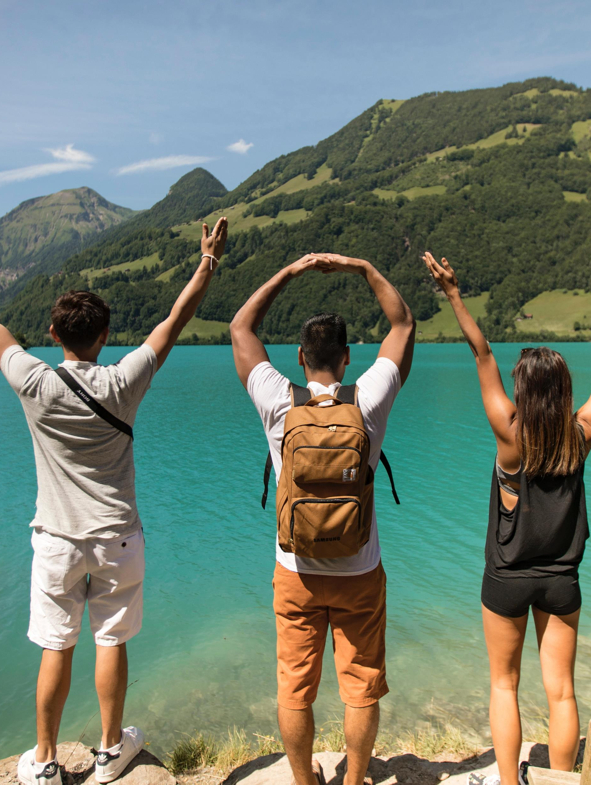
Characteristics of the Geotourist
Hose‘s typology: Dedicated users (students, specialists) and nondedicated users (casual observers)
Grant‘s typology: Six categories ranging from entertainment to complex understanding
Vasiljević et al.'s typology: Five factors based on travel behavior and attitudes towards nature

Slide 162
Hose‘s typology (1996, 1998, 2000)
Butterflies
general tourists, lacking knowledge in geosciences, use display panels and leaflets and appreciate mainly the aesthetic beauty of the site
Beetles
postgraduate and graduate students conducting fieldwork and using academic papers to guide their understanding of the site

Slide 163
Grant‘s typology (2010)
Unaware visitor: visits with no previous knowledge of the site and impressions are based predominately on the aesthetic appeal of the site
Aware visitor: similar to the first group but has gained some knowledge of the site prior to the visit
Interested visitor: shows interest in the educational aspect of the visit, but with no specific preference
Geo-amateurs
Geo-specialists
Geo-experts

Slide 164
Vasiljević et al.‘s typology (2018)
Local community oriented: cares for the local community and their involvement in tourism development
Environmentally aware: nature protection oriented and believes in the detrimental impact of people on nature
Nature-based traveller: high regard for nature, particularly wild nature
Eco-responsible: environmentally oriented and believes in the sustainable use of resources
Plog psychocentric: focuses on more well-known and explored destinations

Slide 165
Interpretation methods
Outdoor interpretation panels
Indoor graphic panels and displays
Live interpretation
Publications
Activity packs/areas
Low-tech and high-tech interactive displays
Audio media
Tactile media
Websites and interactive apps
Arts media
Drifting Apart (2018)

Slide 166
geoparks
[…] geoparks are territories with particular geological heritage and sustainable territorial development. They are areas of interest for scientific research and education but also aim to provide the necessary conditions for development of natural and cultural tourism (Nikolova and Sinnyovsky, 2019, p. 141).
The UNESCO geopark concept was developed in 2015 as a result of the requirement to protect ecologically sensitive and significant areas.
Strategic objectives: Credibility, Conservation, Capacity, Communication, Communities (World Heritage Concvention, Budapest 2002, 2007)
Global Geoparks Network (GGN)

Slide 167
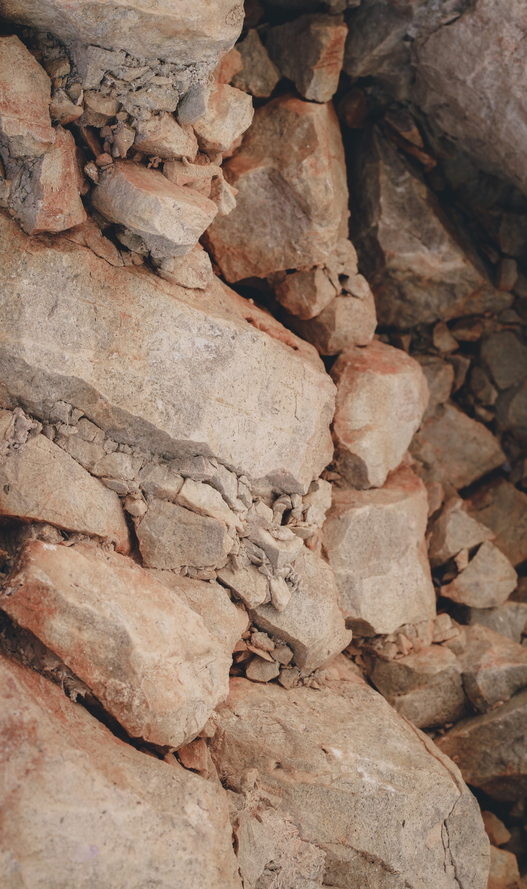
European geoparks and their interpretation
81 geoparks across 26 countries
The European Geopark Network – seeks to develop sustainable geotourism on a European scale through the promotion of nature heritage in these regions (europeangeoparks.org, 2021).
Interpretation across Europe should focus on:
Telling the visitor about the destination/attraction
Educating them about their role in the conservation of these sites

Slide 168
Bergstraße-Odenwald UNESCO Global Geopark, Germany
Over 30 geopark trails with information panels at „geopoints“.
Geo-education and geo-adventure activities delivered by 45 geopark rangers
Activities include geology, water, forest, agriculture, and history tours for children and active hiking tours for adults

Slide 169
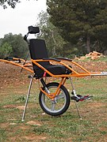
Parco Delle Madonie, Sicily, Italy
Off-road wheelchair (Joelette) available for visitors with reduced mobility
"Madonie at a slow pace" philosophy for inclusive nature exploration
Leading the European "VR @ Geopark" project for promoting geoparks through advanced technology

Slide 170
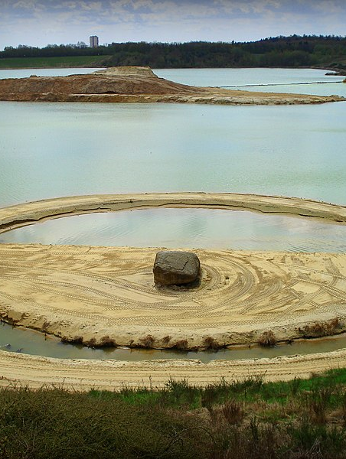
De Hondsrug UNESCO Global Geopark, the Netherlands
Unique ice age landscape with parallel ridges and dry valleys
Cycling tours for visitors of varying abilities: boulder trip, ice age tour, farmers trail, and Van Gogh cycling tour
Trails brought to life with virtual and augmented reality experiences
Sabre-toothed tiger trail for children and Leewal time travel trail for adults

Slide 171
Marble Arch Caves UNESCO Global Geopark, Ireland and the UK
Diverse landscapes including uplands, lakes, forests, and drumlins
Wildlife Detective Activity for children: mini beast scavenger hunt and animal seek and find
Guided walking tours for cave exploration
Virtual reality experience to access areas not physically visitable

Slide 172
Geopark Ries, Germany
Impact crater Nördlinger Ries, the best-preserved crater in Europe
Network of info-centers and info-points providing geopark knowledge
"Lauschtour" (Eavesdropping) audio guide for self-guided excursions
Audio guides available via app or rental iPhones
QR code scanning for audio delivery along the route

Slide 173
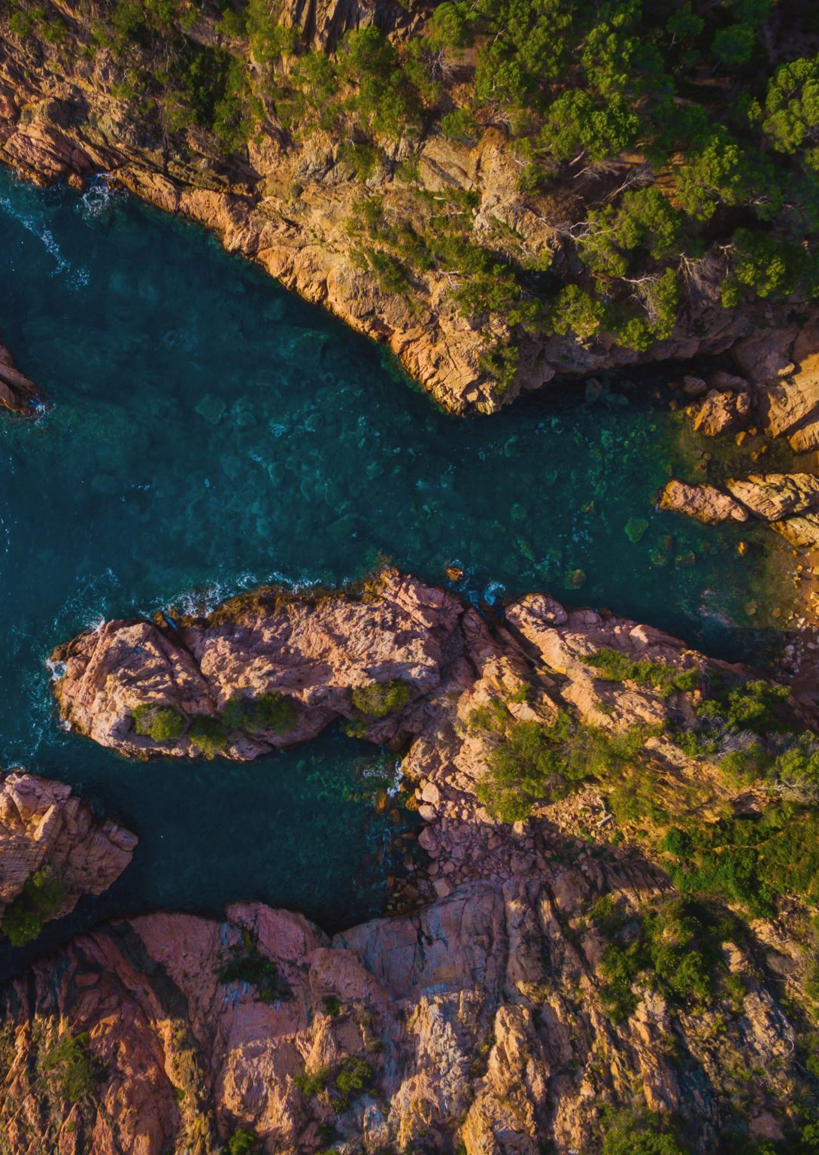
Coastal landscapes and nature heritage
The tourism industry in coastal regions is restructuring to meet changing demands
Interpretation methods such as guided kayak tours, wild sea swimming activities, and coastal boat trips are popuplar in coastal landscapes

Slide 174
The Wild Atlantic Way, Ireland
Over 2,500 km, the longest defined coastal touring route in the world
Story interpretation panels
Photo points
The Atlantic Way Explorer Mobile App
Directional road signs

Slide 175
Lough Hyne, Co. Cork
Semi-enclosed marine lake in Southwest Ireland
Highly oxygenated seawater with rich biodiversity and unique marine habitats
Guided Kayaking Tours
Guided and self-guided walking tours

Slide 176
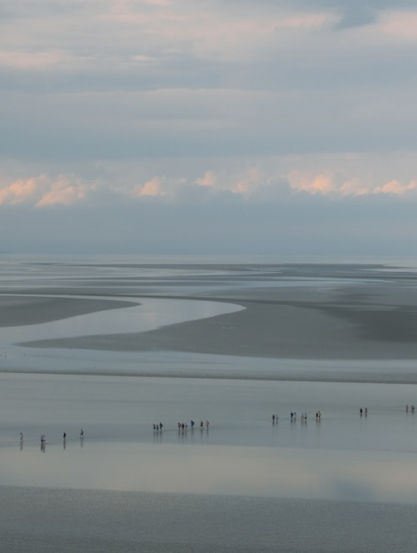
The wadden sea
Coastal area along the European North Sea coast; spans the Netherlands, Germany, and Denmark
Diverse inanimate features: islands, tidal flats, salt marshes, wetlands, dunes
Official website
Educational programs and visitor centers
Mobile app
Guided and interactive tours
Exhibitions showcasing migratory birds and stories from the Wadden Sea
Education programs and education portal

Slide 177
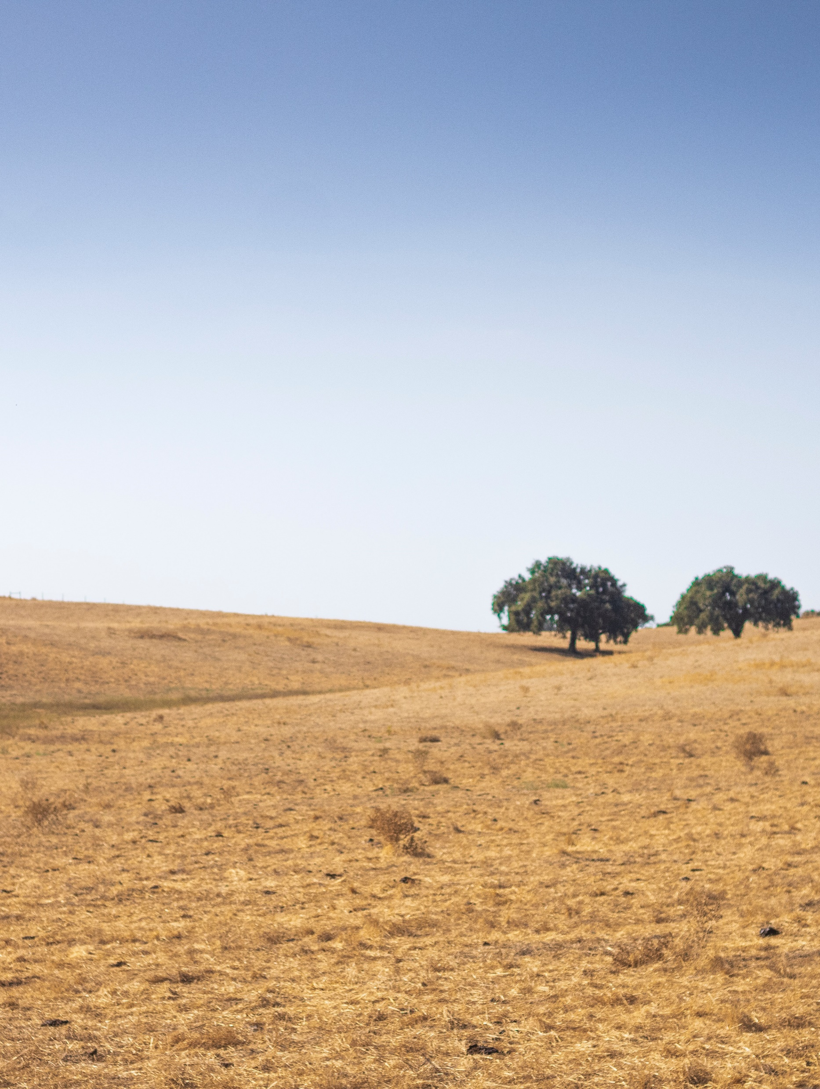
Natural Park of Southwest Alentejo and Cape St. Vincent
Covers over 100 km along Portugal's western coast
Diverse geological and biological natural heritage; unique flora and fauna due to the unique climatic conditions
Guided and self-guided walking and biking tours
Interpretation panels
Birdwatching viewing points and sunset boat tours

Slide 178
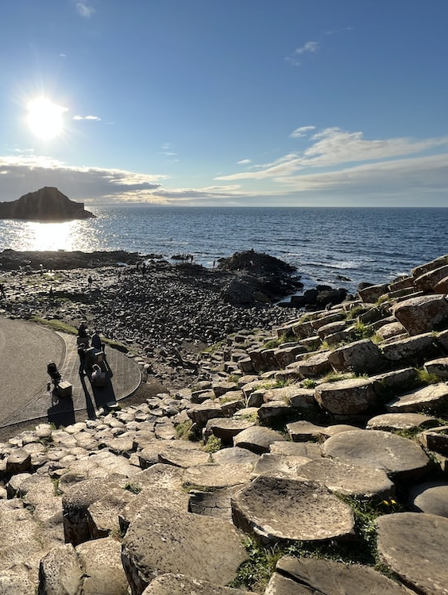
The Giant’s Causeway and its coast, Northern Ireland
193 km rugged coastline in Northern Ireland
Diverse marine life and nesting seabirds
Outdoor panels with site-specific information and maps
Way-markings for driving route identification
Information centre – multilingual audio guides, trails, interactive exhibition

Slide 179
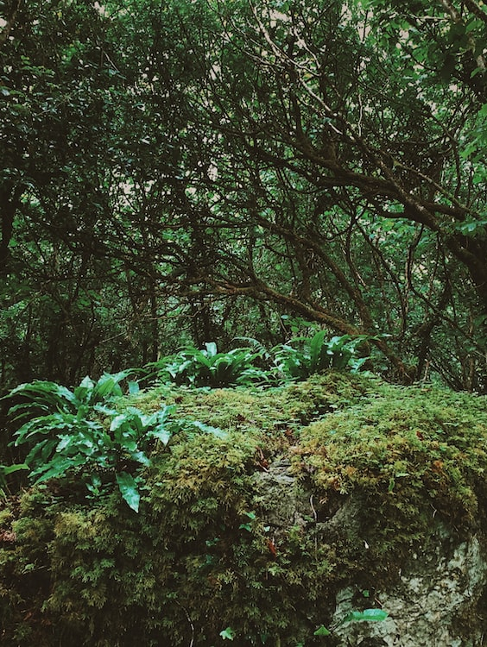
case study: Burren and Cliffs of Moher Geopark
UNESCO site from 2015
Geological shaping of the Burren over millions of years
Contrasting shades of rock in the landscape (Burrengeopark.ie, 2021).
Folded rocks and slits in limestone due to a collision with the European continent (Burrengeopark.ie, 2021).
Rain dissolving limestone over millennia (Burrengeopark.ie, 2021).

Slide 180
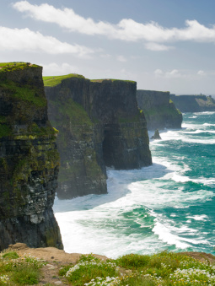
Burren and Cliffs of Moher Geopark
Longest underground cave system in Ireland and longest stalactite in Europe
Cliffs of Moher as the highest cliffs in Ireland
Diverse fauna – feral goats, foxes, hares, birds, butterflies
Variety of interpretation methods – guided walks, sea cruises, cave tours, foraging experiences, and interactive exhibitions
Interpretive resources – geopark map, visitor guide, free magazine
Additional interpretation materials – food trail, slow food festival, cookery book

Slide 181
summary
Geotourism definitions and the tourists involved – interpreatation can be organized depending on their level of interest and knowledge of the geology of the area
Interpretation methods such as guided kayak tours, wild sea swimming activities, and coastal boat trips are popuplar in coastal landscapes.
European examples of Geoparks, best practices
Case study: Burren and Cliffs of Moher Geopark

Slide 182
references
Burrengeoparks, (2022). Retrieved November 13, 2021, from https://www.burrengeopark.ie/learn-engage/
Drifting Apart, (2018). Drifting Apart: Inspiring interpretation on an international scale. Retrieved March 14, 2022 from https://driftingapart.ccght.org/wp-content/uploads/sites/14/2018/11/WP3-Best-Practice-Interpretation-Guidelines-Toolkit.pdf
Dowling, R. and Newsome, D. (eds) (2018). Handbook of Geotourism. Edward Elgar Publishing, London.
Europeangeoparks, (2021). Meet Our Geoparks. Retrieved October 20, 2021 from http://www.europeangeoparks.org/?page_id=168
Nikolova, V. and Sinnyorsky, D. (2018). Geoparks in the Legal Framework of the EU Countries. Tourism Management Perspectives, 29, 141-147.

Slide 183
Output of the Erasmus+ K2 Strategic Partnership Project Nr. 2020-1-CZ01-KA203-078407 „Methodology of Interpretation of European Nature Heritage in Tourism" 2020 – 2023
Participating universities and their academic teams
Prague University of Economics and Business, Czech Republic;
Alexandru Ioan Cuza University of Iași, Romania;
Fachhochschule des Mittelstands, Germany;
Munster Technological University, Cork, Ireland
Universidad Europea de Madrid, Spain;
Universidade do Porto, Portugal;
University of Applied Sciences Burgenland, Austria;
Vytauto Didziojo Universitetas, Lithuania.

